Slide 1
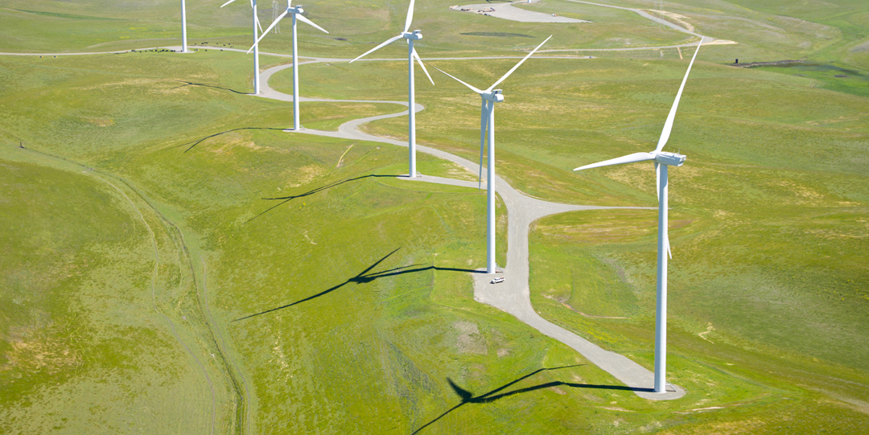


Solano 4 Wind Project
Solano County ALUC Consistency Determination Review
May 20, 2021
Powering forward. Together. SM

Slide 2
Agenda
Introductions
Solano 4 Wind Project Benefits
Proposed Project
Solano 4 Wind Project Status
SMUD Solano 4 Consistency
Conclusion
Notes:
We thank Jim and his staff for their efforts to help us understand the ALUC application process and their hard work on processing the application in time for inclusion in the May meeting and thank the Commissioners for the time to present it to them.

Slide 3
Solano 4 Wind Project Benefits
Combatting climate change is not only a State mandate, but it's also one of the highest priority matters for SMUD, our Board of Directors and the community we serve.
Power generated from Solano 4 is critical to SMUD’s goal of achieving a carbon-free energy portfolio by 2030. Wind power is key to these objectives by delivering power when the need is greatest.
Provide approximately 200 construction and construction related jobs.
Provide approximately 100 additional jobs supported in the state and local economy.
Construction is expected to contribute $22.5 million to the local economy.
Expected to contribute $440,000 a year to the local economy during operations.

Slide 4
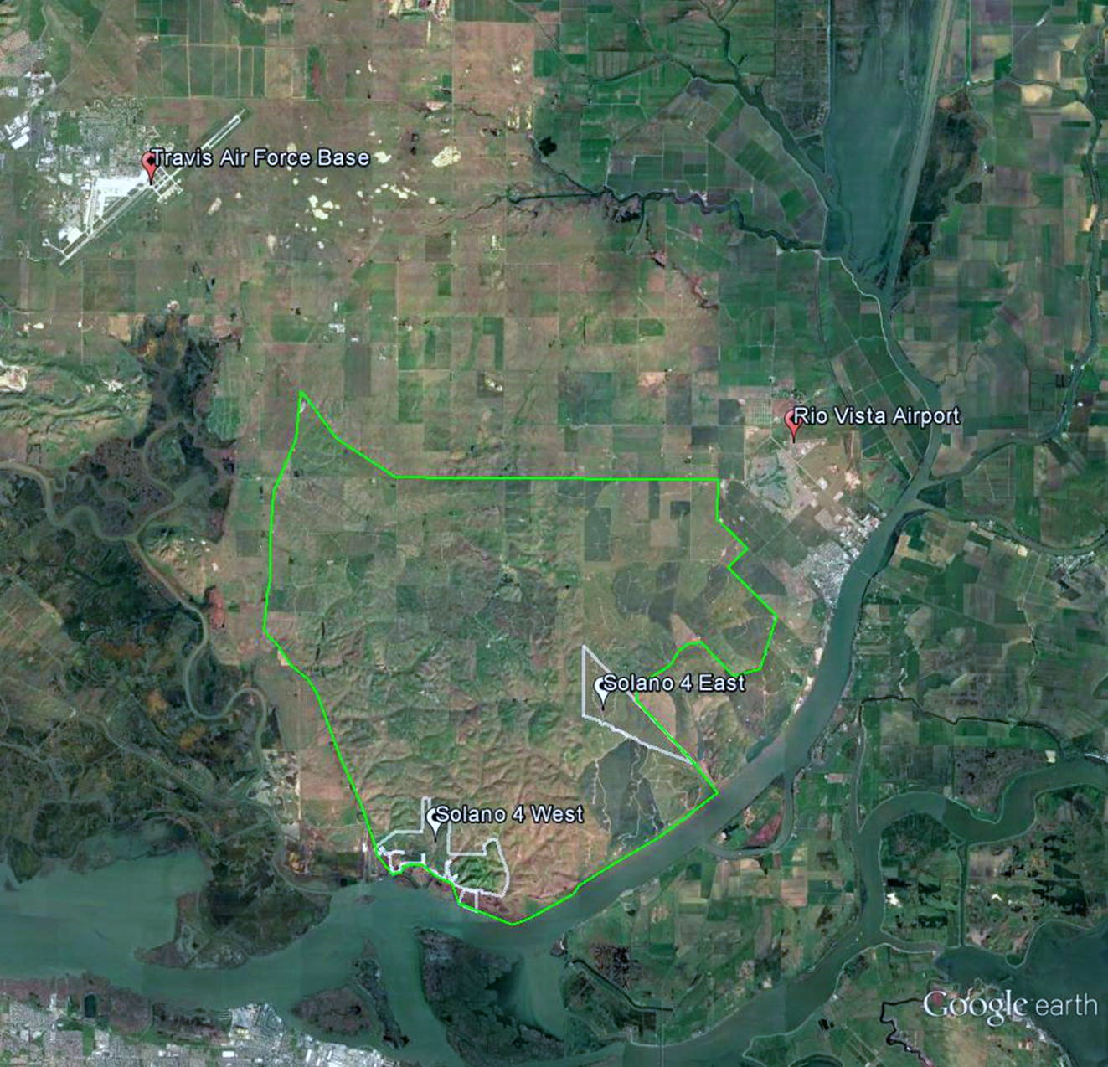
Solano Wind Resource Area
Solano Wind Resource Area (Green):
5.5 miles from TAFB
2.4 miles from Rio Vista Airport
Solano 4:
12 miles from TAFB
5.5 miles from Rio Vista Airport
Notes:
Closest points to the project property: TAFB 12 mi, Rio Vista Airport 5.5 mi,
Closest points to the WRA: TAFB 5.5 mi, Rio Vista Airport 2.4 mi

Slide 5
Solano 4 Project Location Map

Slide 6
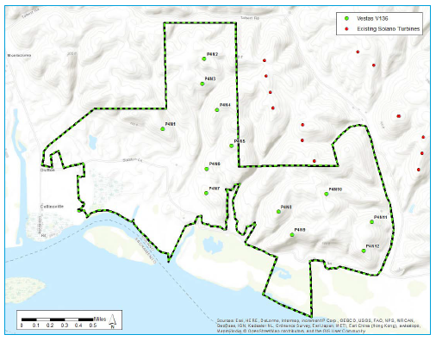
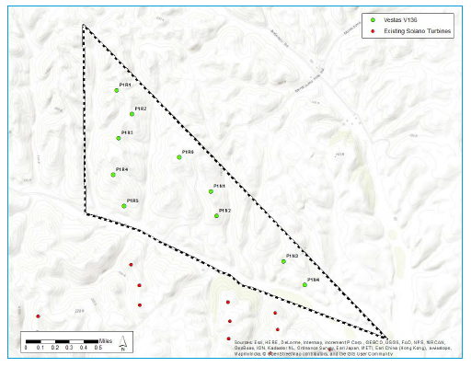
Proposed Project: Solano 4 Wind
Expected to generate 349 GWh annually with 90.8 MW capacity. Provide environmental, land use and economic benefits to the region. Generate almost 10 times the power (40,000 homes) of the former projects.
Solano 4 West
Solano 4 East
Construction and operation of 10 new wind turbines.
Decommission 23 older, less efficient wind turbines and replace with 9 modern wind turbines

Slide 7
Solano 4 Wind Project Collaboration
SMUD has worked collaboratively with Solano County Airport Land Use Commission and Travis AFB to develop this project. Ready for construction phase.
  CRADA signatory (2010)
  ALUC Selected SMUD as a member of the Renewable Energy and Wind Resource Working groups (2014-2016)
  WTRIM participant (2018-2019) and provided data to support their analysis
  Regular meetings with Travis AFB and Solano County staff and Airport Land Use Commission members (2010-present time)

Slide 8
Solano 4 Wind Project Collaboration (cont.)
Project FAA Determinations:
  SMUD filed for project determinations with the FAA in 2018, Travis AFB did not raise concerns with the DoD Clearinghouse at this time.
  In 2019 SMUD received FAA Determinations of ‘No Hazard’ for the project.
  After the comment date Travis AFB raised concerns with SMUD.
  SMUD met with Travis AFB and coordinated the extension process to assure its participation.
  Notice of Presumed Risk issued by the DoD, MRT formed.
  Travis AFB and its experts concluded assessment in December 2020 and provided input to the FAA/Department of Defense (DoD) process.
  The DoD Clearinghouse issued a Mission Compatibility letter in February 2021.
  FAA issued extensions to the Determinations of ‘No Hazard’.

Slide 9
Solano 4 Wind Project Status
The Request for Proposal for Construction and Operation was released this month.
Final Environmental Impact Report planned for release in June 2021.
Target award of Construction Contract in Q4 2021.
Decommissioning of Solano 1 and Construction of Solano 4 expected to take approximately 1.5 years.

Slide 10
Radar Quantitative Analysis
SMUD designed Solano 4 while performed radar impact studies to assure that the Project would have negligible to no impact on the Travis AFB radar.
SMUD worked extensively with Travis AFB to ensure the project will not present a concern for their radar or operations and received FAA approval for the project.
MRT process included a review of quantitative data provided by Westslope.
Westslope to present Solano 4 Probability of Detection (Pd) Impact Study.

Slide 11
Project is Persuasive to meet the Special Condition for Compatibility
ESA Memorandum reports:
SMUD’s application acknowledges that the Project is inconsistent with the line-of-site criteria provided in Policy 5.6.1(b) and points out that under Policy 6.2.4(c)(6), the ALUC has the discretion to recognize “there may be specific situations where a normally incompatible use can be considered compatible because of terrain, specific location, or other extraordinary factors or circumstances related to the site.”

Slide 12
Project is Persuasive to meet the Special Condition for Compatibility (Cont.)
ALUC is obligated to “make specific findings as to why the exception is being made and that the land use will neither create a safety hazard to people on the ground or aircraft in flight nor result in excessive noise exposure for the proposed use nor impact airport military operations.”
  Modeling of the replacement wind turbines was conducted to identify a number and specific locations of the wind turbines to ensure that there will be no material difference on the performance of the DASR and on Travis AFB’s tracking and display system, the Standard Terminal Automation Replacement System (STARS) and that Travis AFB’s key radar system used for air traffic control, the Monopulse Secondary Surveillance Radar (MSSR) which is co-located with the Travis AFB DASR, will not be affected.
  The DNH states that the results of the FAA’s aeronautical study indicate that the Project would have “no substantial adverse effect on the safe and efficient utilization of the navigable airspace by aircraft or on the operation of air navigation facilities.” The FAA thus determined that the Project would not be a hazard to air navigation.
  There are no noise and safety criteria applicable to people or buildings on the ground in Compatibility Zones D and E.
ESA analysis found that the SMUD application was “persuasive in supporting the position that special conditions apply to the proposed development.”

Slide 13
In Summary and Request
In Summary:
No net change in impact to Travis AFB radar as confirmed by Travis, DoD, FAA and Westslope.
Solano 4 Wind will neither create a safety hazard to people on the ground or aircraft in flight nor result in excessive noise exposure for the proposed use nor impact airport military operations.
SMUD Request:
That the Commission finds the Project consistent with the Travis LUCP under Special Condition Policy 6.2.4(c)(6).

Slide 14
Back Up Slides
Back Up Slides

Slide 15
CEQA Status
NOP 30-day public comment period (1/9/19 – 2/8/19), Scoping Meeting (1/22/19)
Draft EIR 45-day public comment period (7/23/19 – 9/6/19), Public Meeting (8/20/19)
Received comments from DOT Division of Aeronautics, Solano County Department of Resource Management, and SMW on behalf of the ALUC
Final EIR will include our response to comments, we will send out the FEIR to commentors 10 days before we present to the Board.
We will present the EIR to the Energy Resources and Customer Services Committee on June 16 and to the Board on June 17.

Slide 16
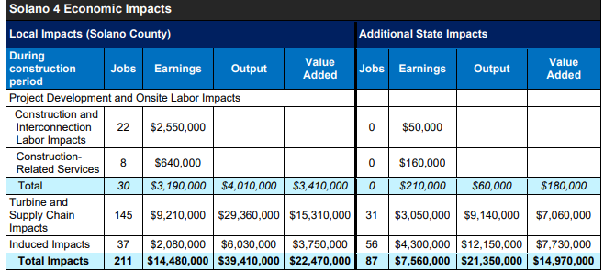
Economic Impacts of Solano 4 Wind
The economic impacts of the Solano 4 Wind Project using the Jobs and Economic Development Impacts (JEDI) land-based wind model, developed by the National Renewable Energy Laboratory (NREL) provides significant value locally including jobs

Slide 17
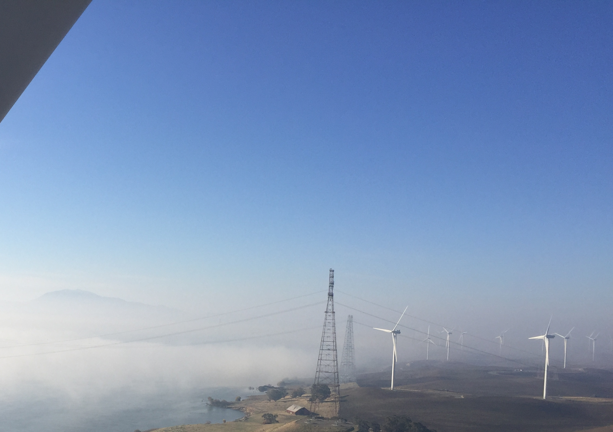
View from the Turbine
California Oregon Transmission Tower in the foreground
PG&E Tesla Towers in the background

Slide 18
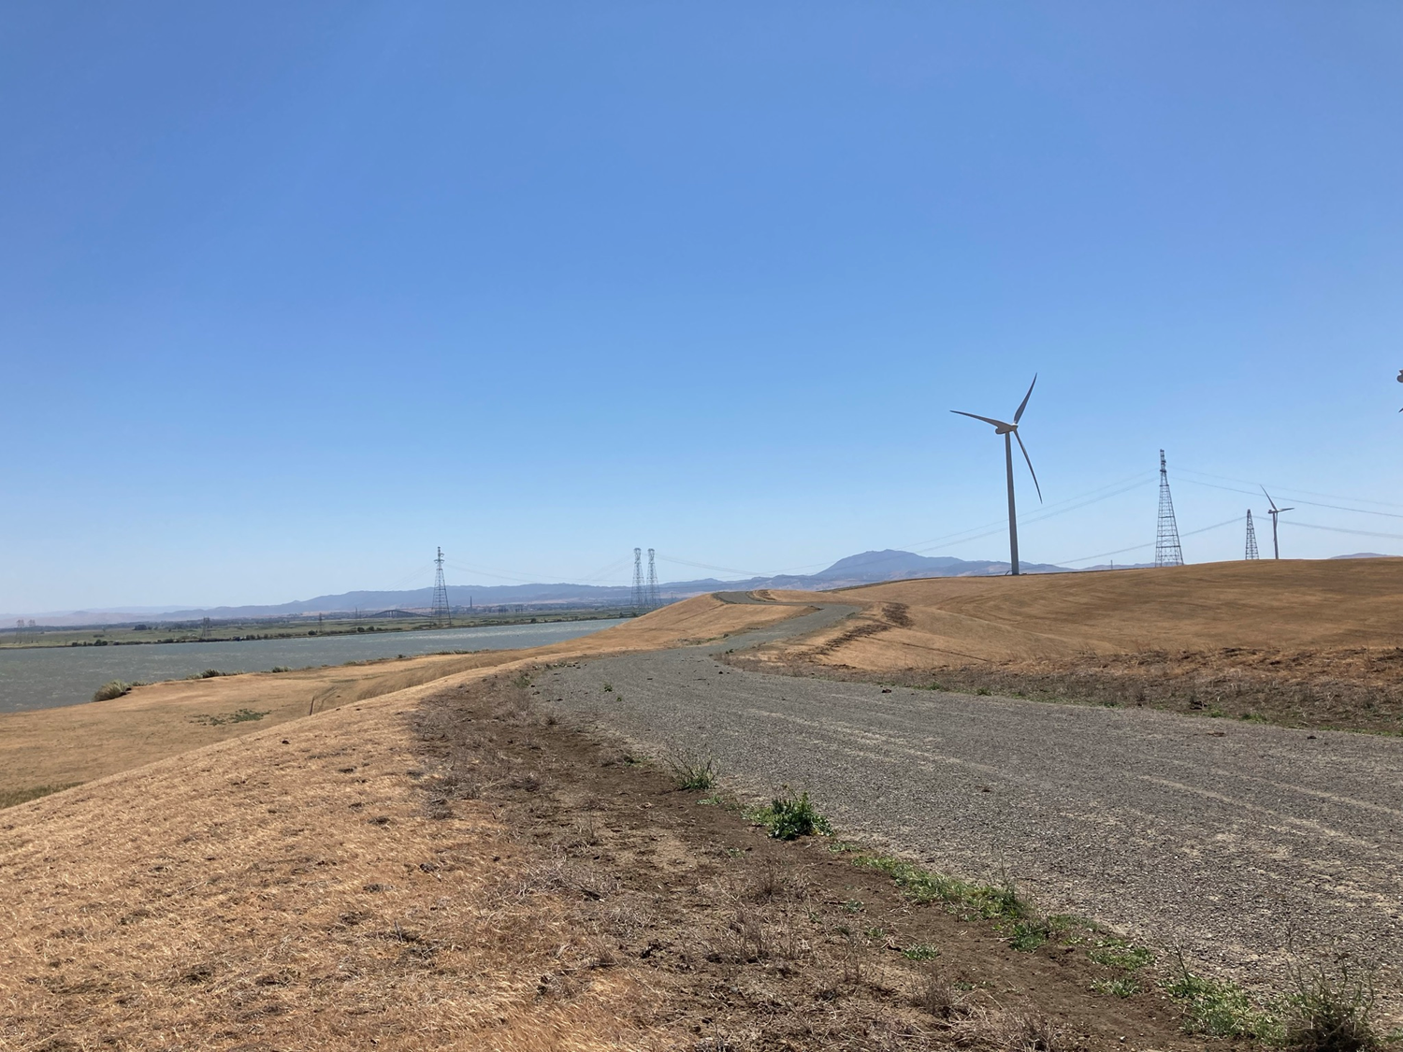
South towers
California Oregon Transmission Tower in the foreground
PG&E Tesla Towers in the background

Slide 19
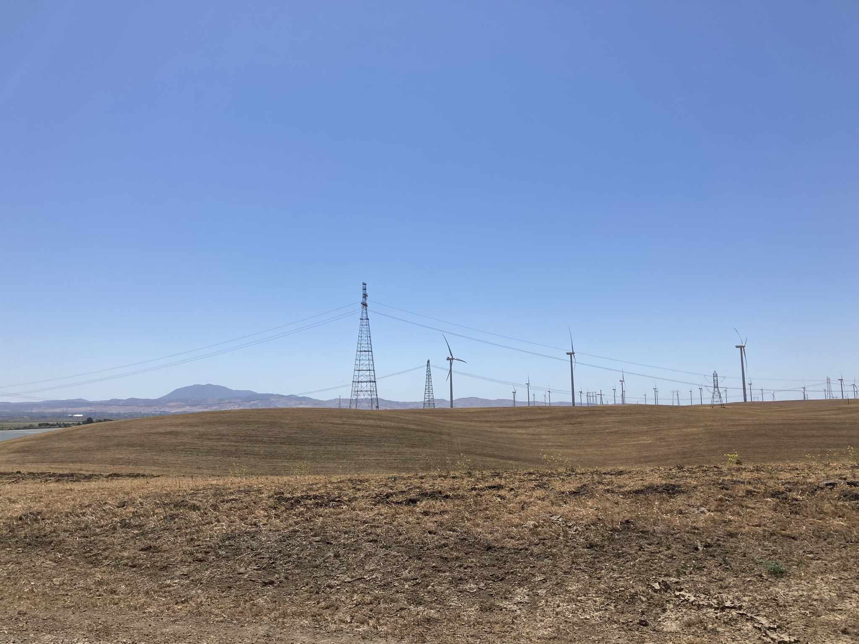
River Span Towers, North side
California Oregon Transmission project foreground
PG&E Tesla background
Note size of normal transmission towers with respect to river crossing towers

Slide 20
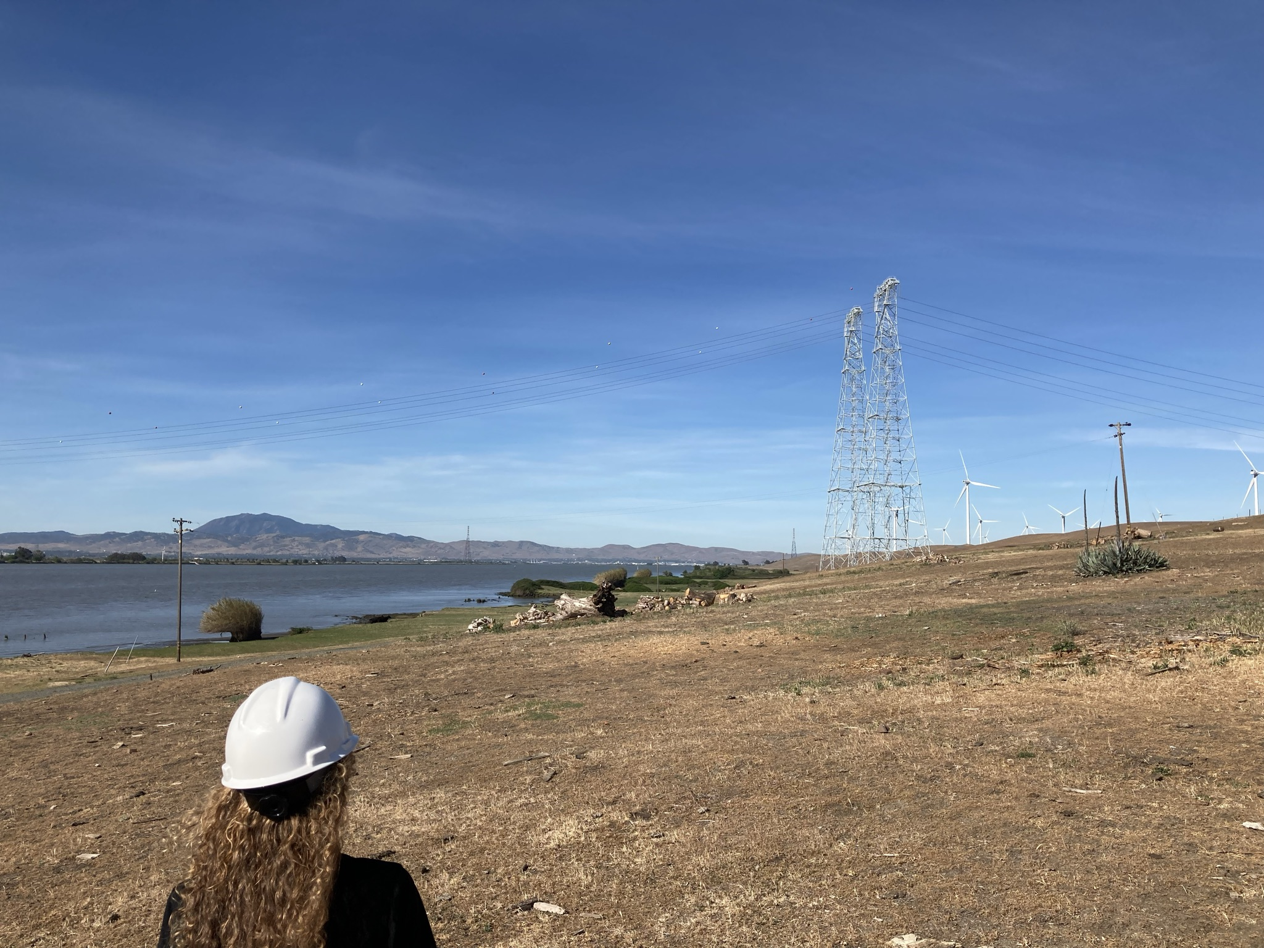
PG&E Towers
PG&E Tesla Towers in the foreground
PG&E Vaca-Dixon/Contra Costa lines in the distant background, approximately 200’ south of SMUD project

Slide 21
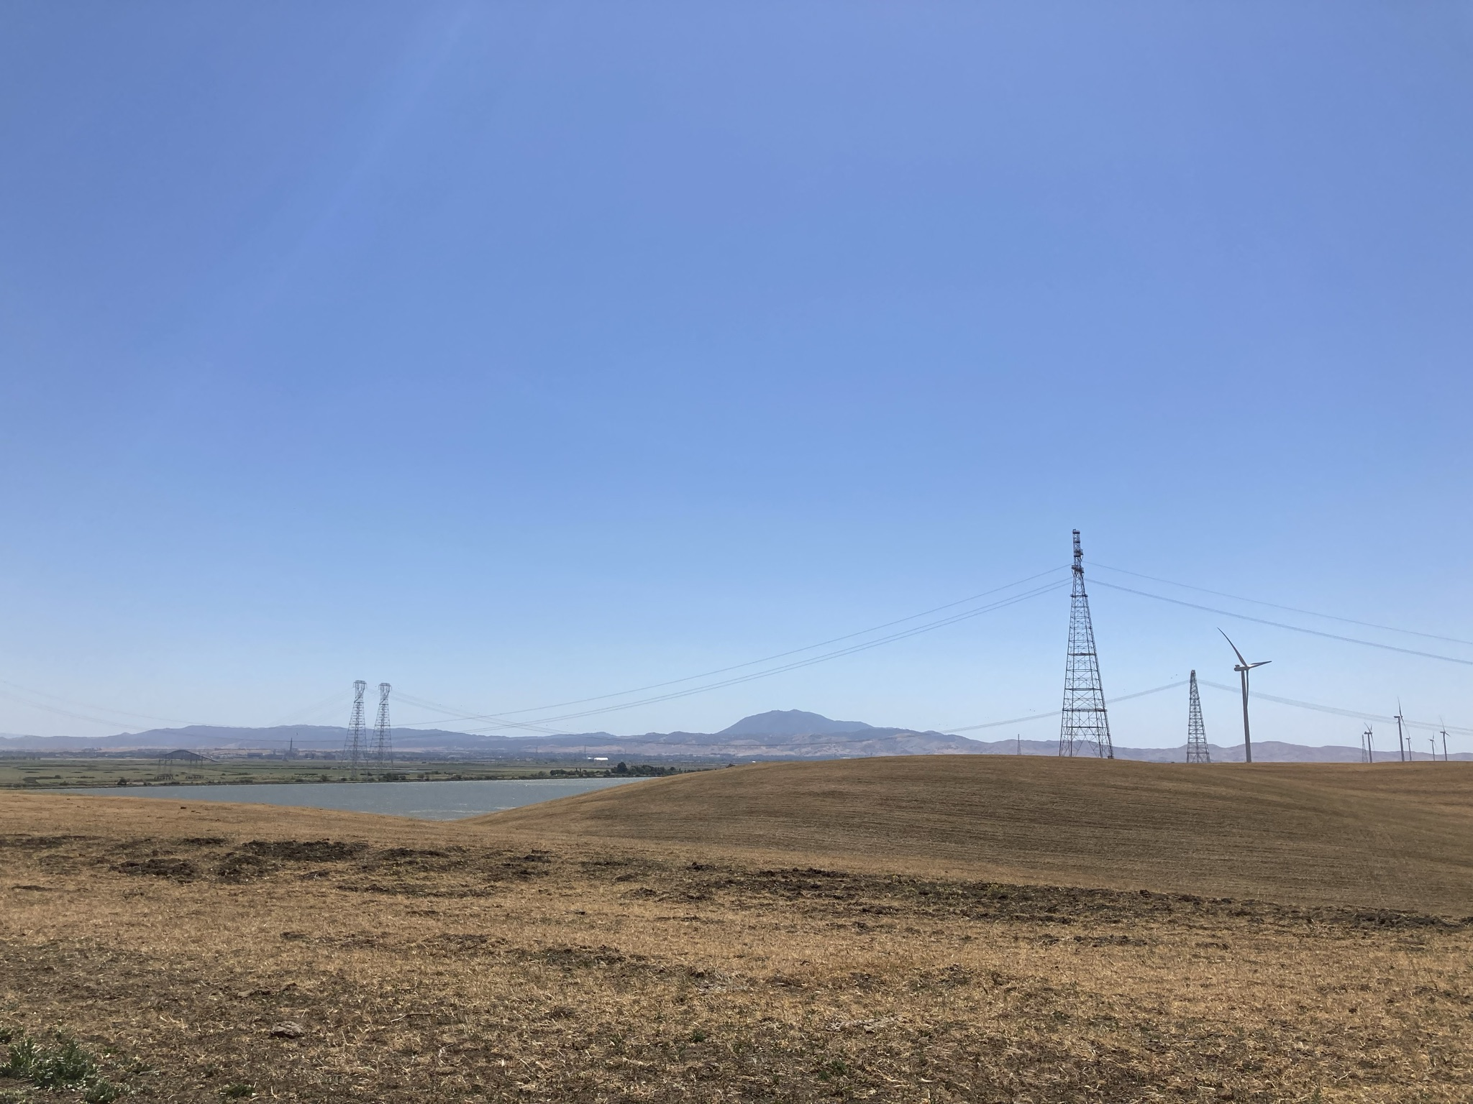
River Crossing

Slide 22
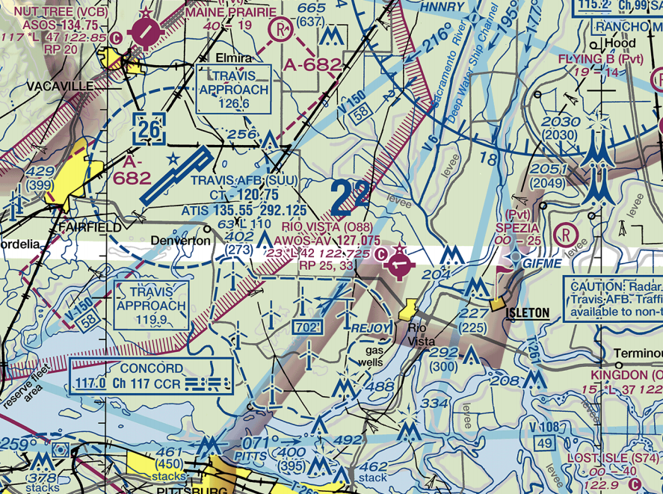
San Francisco Sectional

Slide 23
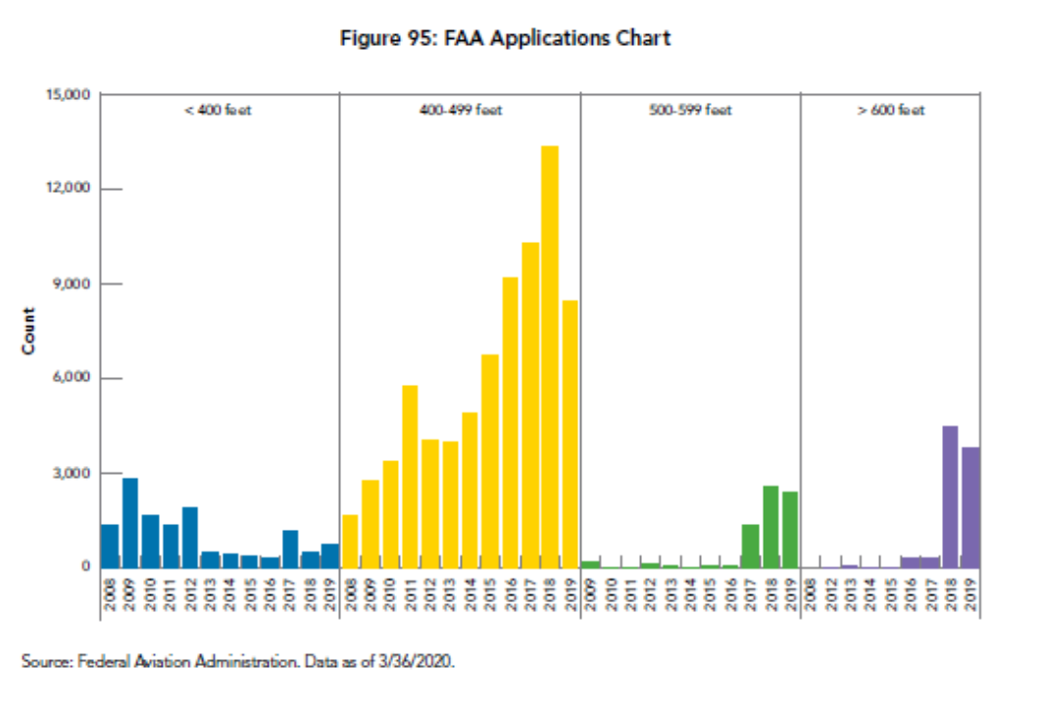
Wind Turbine Height Trends

Slide 24
Relative Impact of SMUD Solano 4 Project in the Resource Area
There are 560 turbines within the Solano Wind Resource area.
SMUD Solano 4 Project takes down 23 turbines in primary radar line of site and replaces them with 19 in line of site turbines as currently proposed.

