Slide 1
CERS Online Reporting
Training for Business
Notes:
Welcome participants to the CERS Business training.
Introduce yourself.

Slide 2
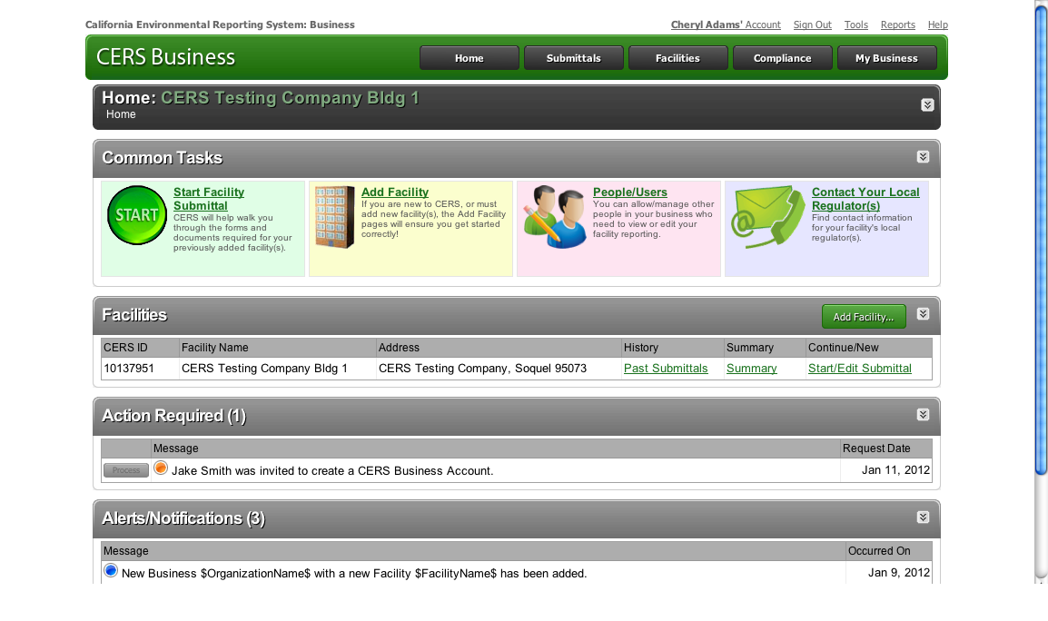
Agenda
Modules
Introduction
Navigating the Website
Getting Access/Creating a CERS Account
Finding or Adding a Facility
Managing Users
Making a Submittal
Hazardous Materials Inventory
Uploading Maps and Documents
Businesses/Organizations
Wrap Up
Questions
Notes:
Explain
The full training is standardized and posted on the CERS website home page at http://cers.calepa.ca.gov/. The version you will hear today has been shortened to keep the session to approximately one hour plus time for questions. (Indicate if your agency has further modified it in any way).
Questions should be held until the end of each module and then should be specific for the module. A general question and answer period will be provided at the end of the presentation.
This is your CERS Home Page. From here you will be able to perform all of your required reporting and related activities. We’ll cover the website in more detail as we go through the presentation.

Slide 3
CERS Business Training
Introduction to CERS
Module 1

Slide 4
What is CERS?
CERS = California Environmental Reporting System
A statewide, web-based system
Supports businesses and Unified Program Agencies with electronically reporting, collecting, and managing hazardous materials-related data
Mandated by the California Health and Safety Code and AB 2286
Notes:
Beginning of Module 1: Introduction to CERS
Explain
CERS is a statewide, web-based system to support businesses and Unified Program Agencies with electronically reporting, collecting, and managing hazardous materials-related data as mandated by the California Health and Safety Code.

Slide 5
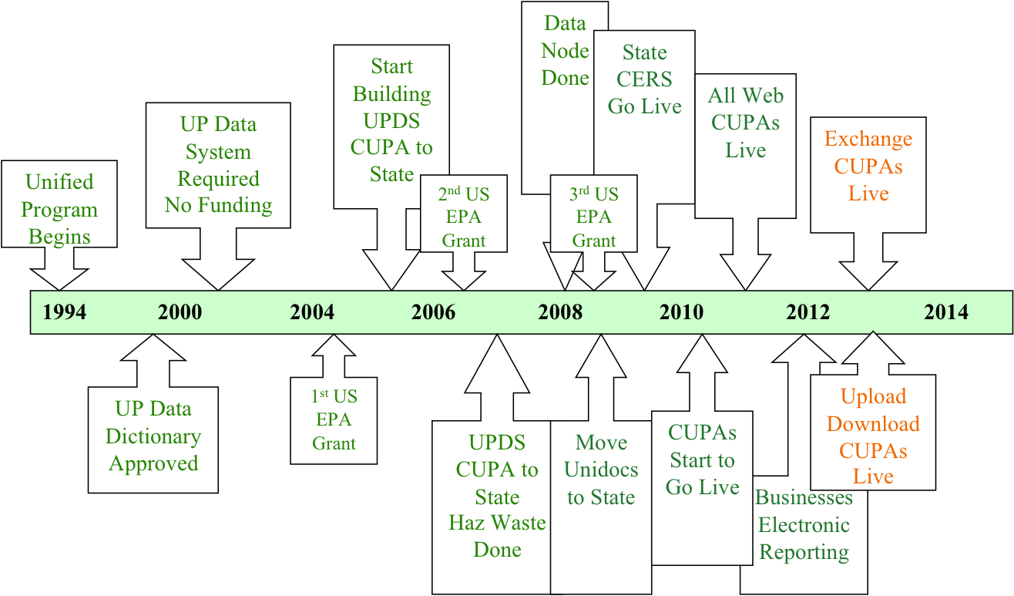
Development of CERS
Notes:
Explain
Electronic reporting has been a goal of Cal/EPA for over 20 years.
Background Information for Trainer
Creation of Unified Program in 1994 to consolidate 6 environmental programs at the local level
Legislative effort to promote electronic reporting began more than 16 years ago with a small pilot project (with no funding)
Jointly created reporting standards (Data Dictionary) in 1998
Cal/EPA, local agency and industry collaboration beginning in the late 1990’s to develop capability to streamline business reporting requirements and improve emergency responder access to hazardous materials related information
Business, legislative, and local, state and federal government cooperation began in 2008 to foster required electronic reporting and the funding to pay for it.

Slide 6
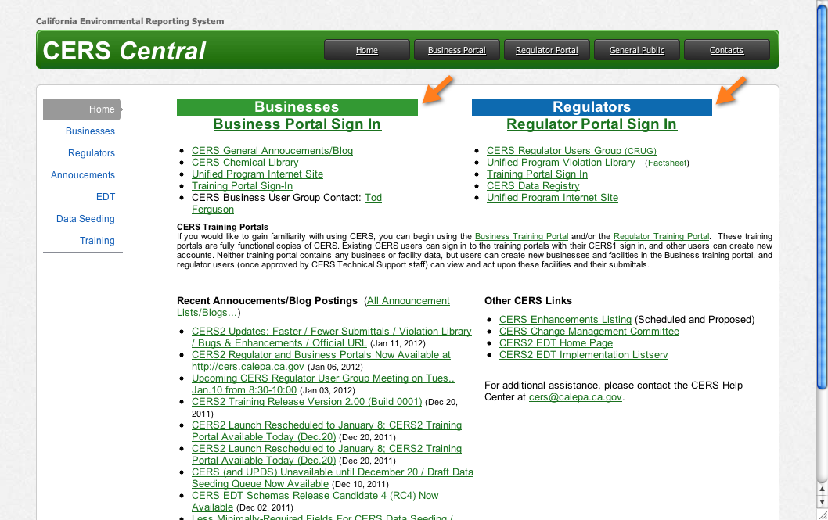
Business and Regulator Portals
Notes:
Explain
CERS now has two separate web portals, one for business reporting and one for Unified Program regulators.

Slide 7
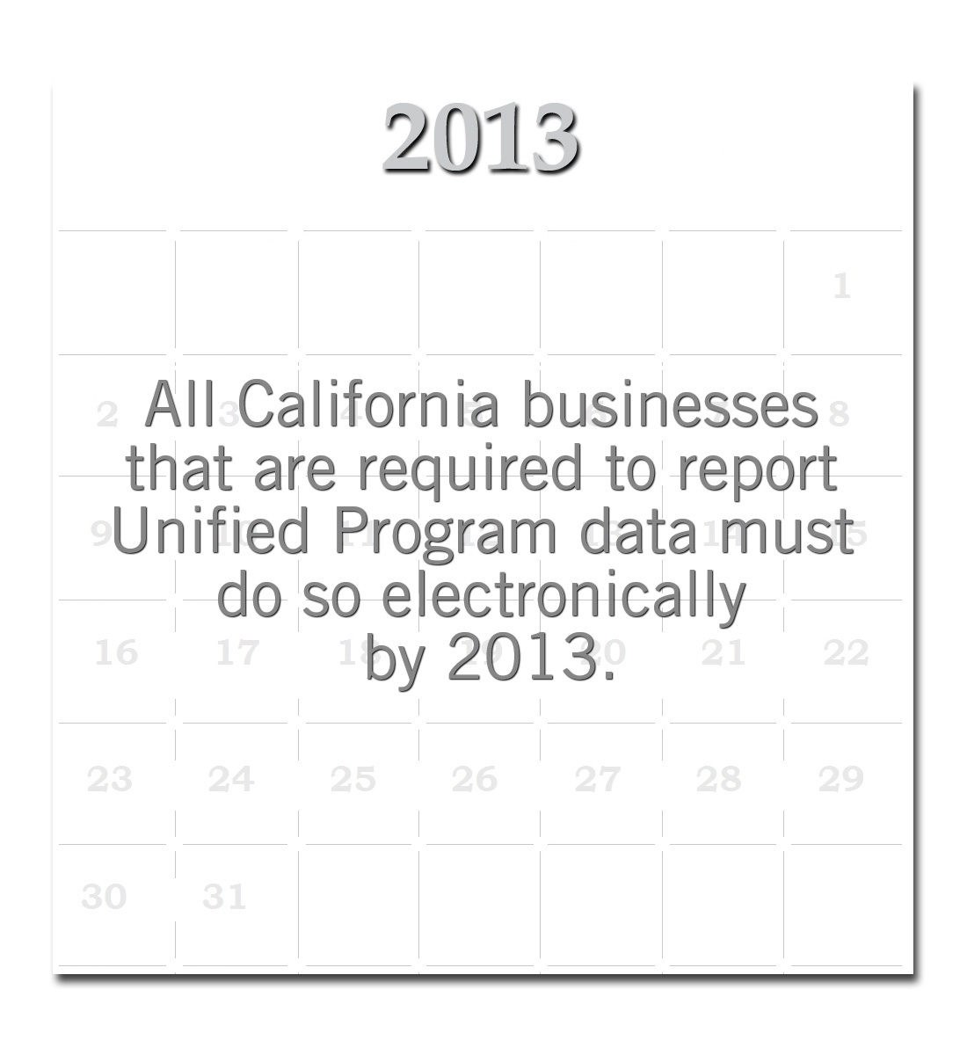
CERS Reporting Requirements
HMBPs
By State law, required to be resubmitted every three years.
HMIS
Must be verified annually, but on the third year would be resubmitted as part of the HMBP.
Notes:
For 1-hour presentation: skip this slide.
Explain
All California businesses that are required to report Unified Program related data must do so electronically by 2013.
HMBPs: By state law, Hazardous Materials Business Plans (HMBPs) are required to be resubmitted every three years.
HMIS verification can be submitted annually but on the third year would be resubmitted as part of the HMBP.
The HMBP includes the HMIS (which includes the site map), Emergency Contingency Plan, and Training Plan.
Existing UST data needs to be reported by January 2014.

Slide 8
Benefits—For You
The new CERS Business portal will:
Step you through the information you must provide for your facility
Allow easier data entry
Provide feedback when required fields and/or screens are not completed.
Allow businesses to submit ALL information and supplemental documentation required under Unified Program regulations
Businesses with multiple facilities can more easily report data for all their facilities.
Notes:
Explain
While CERS may have benefits to the business it is a reporting tool, not a data management tool.

Slide 9
CERS Reporting Requirements
Notes:
For 1-hour presentation: skip this slide
Explain
Many California businesses fall under the Unified Program’s regulatory requirements to assemble and submit data regarding hazardous material regulatory activities, chemical inventories, underground and aboveground storage tanks, and hazardous waste generation.
In most cases, businesses must report this data for each physical site/facility owned or operated by the business. Businesses can use CERS to submit much of this information electronically to their local regulators.
Participants Introductions
Based on the size of the audience,
Ask participants to introduce themselves and state their type of business.
Poll the audience to determine the types of business represented. Call out each business type and ask participants to raise their hand as relevant.
Customize the training based on the audience make-up.

Slide 10
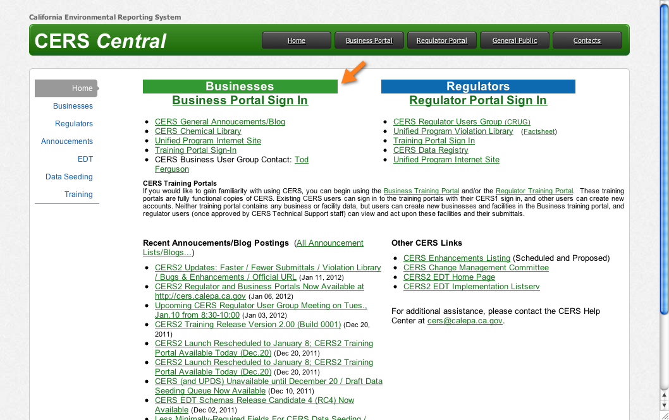
CERS Reporting Options
Full reporting for a first-time entry
Partial reporting
Updating existing records
Notes:
Explain
Reporting options include:
Full reporting for a new business or for first-time reporting of hazardous materials/hazardous waste required information.
Partial reporting
Updating existing records

Slide 11
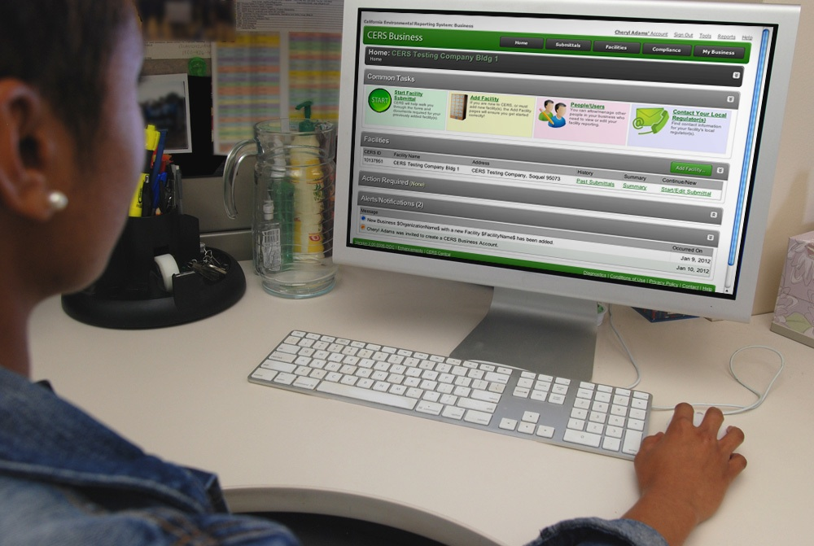
Compatible Browsers
CERS supports these browsers:
Internet Explorer 8 or 9
Safari (current version)
Chrome (current version)
Firefox 3.6 or later
CERS does not support Internet Explorer 7 or earlier versions.
Notes:
End of Module 1: Introduction to CERS
Explain
CERS is an online application. To access it you must have a compatible browser. CERS supports many common current browsers.
It does not support Internet Explorer 7 (which is over 5 years old at this time and used by less than 5% of computer users) or earlier versions.
Questions?
This is the end of this module. Are there any questions pertaining to this module? Please save your other questions to the end of the presentation.

Slide 12
CERS Business Training
Navigating the Website
Module 2

Slide 13
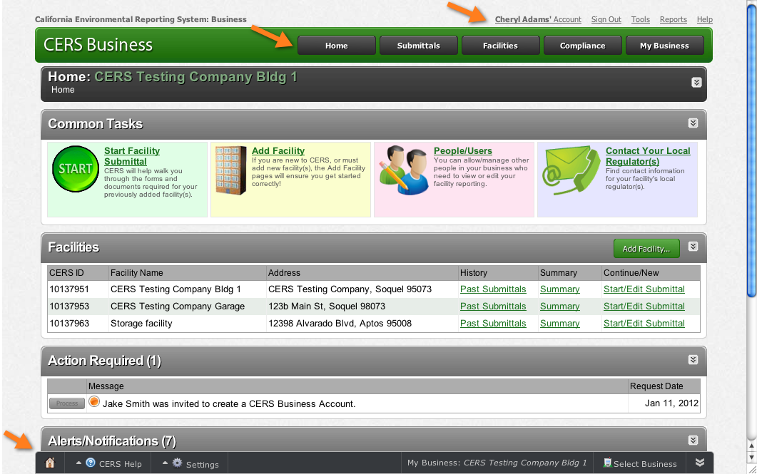
CERS Business Home Page
Notes:
Explain
The Home page is your starting point. CERS provides more than one path for accessing pages.
Let’s take a look at the various paths for accessing important information in CERS.

Slide 14
Contact Your Local Regulator(s)
Notes:
For 1-hour presentation: skip this slide.
Explain
There are two methods for locating information about your local regulator(s).
1-The Contact Your Local Regulator(s) link provides contact information for the regulator(s) for your facility(s).
2-Click the Summary link associated with a facility, to access a page with regulator contact information. This page also shows which regulator is responsible for each aspect of your reporting requirement.

Slide 15
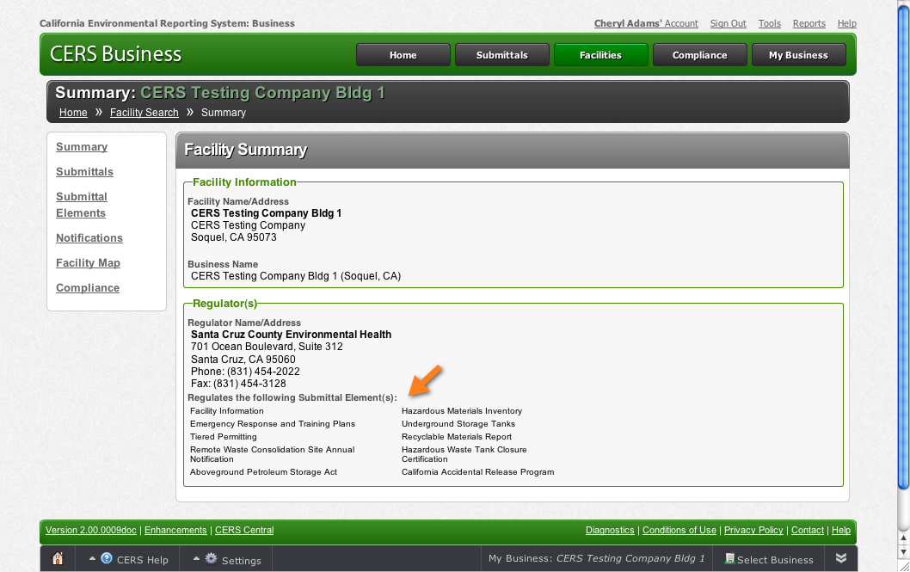
Regulator Information
Notes:
For 1-hour presentation: skip this slide.
Point Out
Notice that the submittal elements are identified on this page.
This business has only one regulator.
Ask
How many people have more than one regulator?
Explain
Eight counties have participating agencies, which means there is more than one Regulator.
Whether you have one or more regulators to work with, this page shows whom to contact if you have a question about a specific submittal element.
If a facility is associated with the wrong local agency, they can contact either CUPA to request that the association be corrected.
In the next section of the training, we’ll review how to complete the various submittal elements.

Slide 16
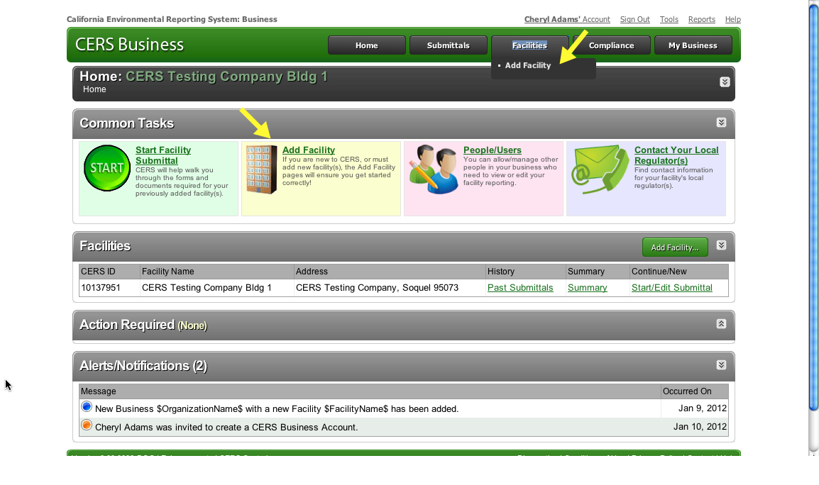
Add Facility
Notes:
For 1-hour presentation: skip this slide.
Point out
There are multiple methods for accessing common tasks from the Home page.
Explain
Add Facility – You have learned how to add a facility when you create a CERS account. If you need to add other facilities, you can do that from the Home page.
Notice the multiple ways to access the task from the Business Home page— the Common Tasks link, the menu, and the Add Facility button.
All three paths prompt you through the steps we just reviewed to add a new facility.

Slide 17
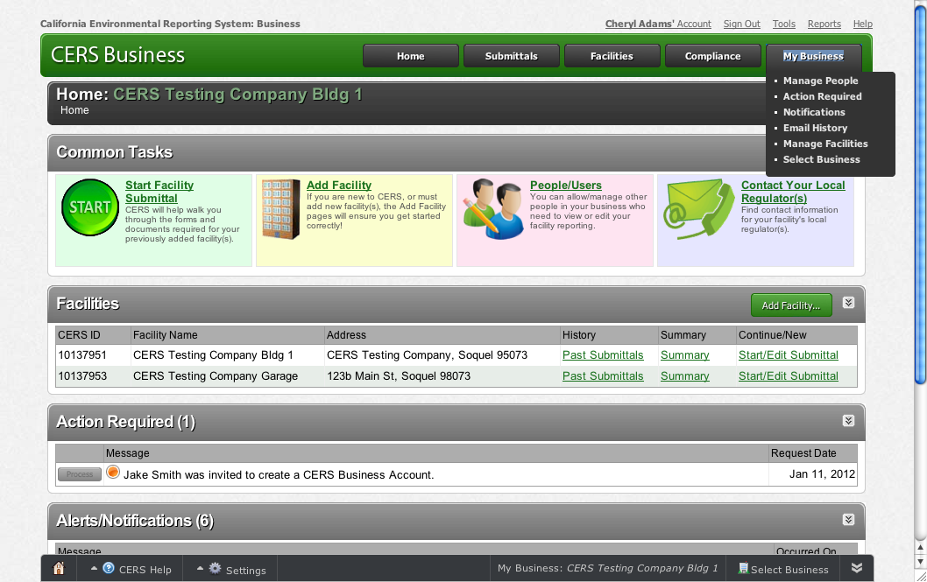
My Business
Notes:
Explain
The My Business button lets you easily access many different pages.

Slide 18
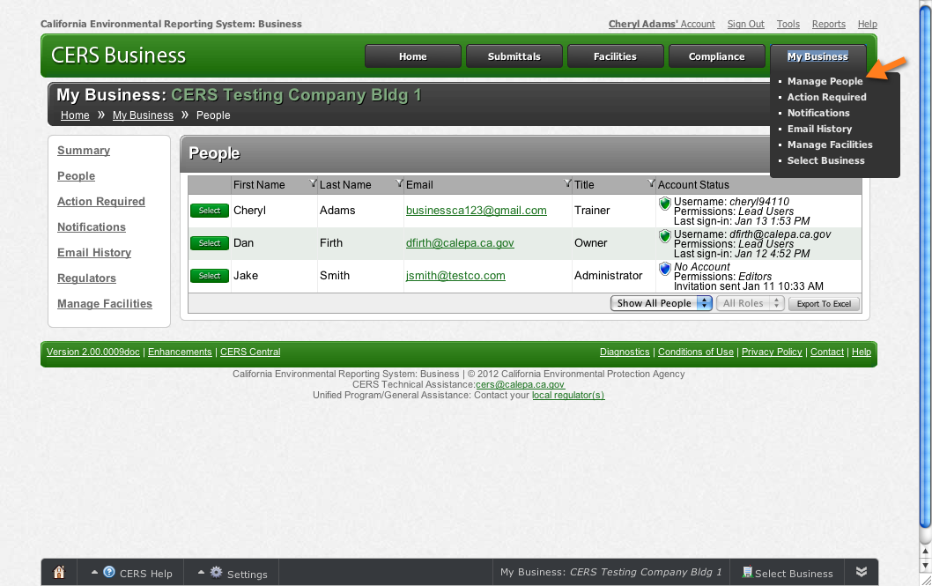
Manage People
Notes:
Explain
Selecting Manage People opens the People page.
Point Out
Notice that the business has completed all the permissions (Lead Users, Viewers, Editors) and Approvers.

Slide 19
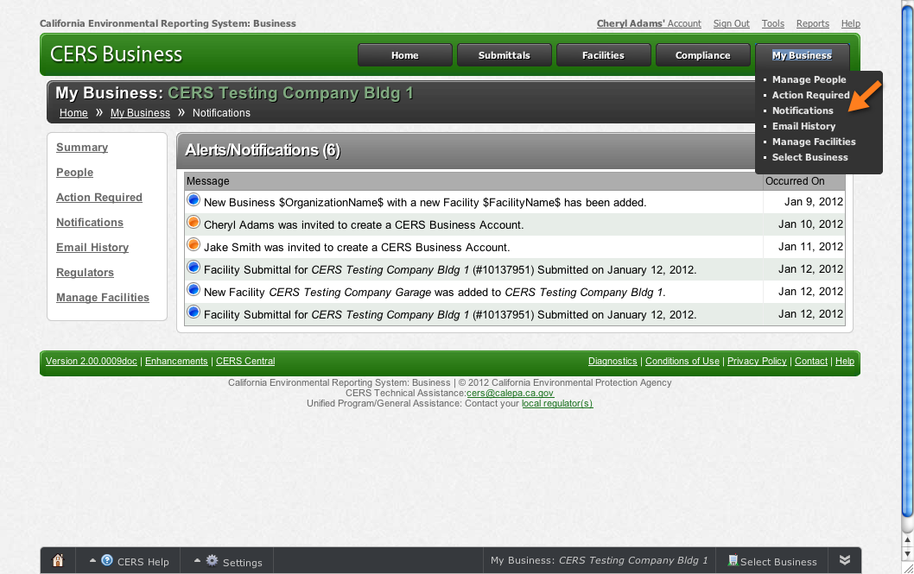
Alerts/Notifications
Notes:
Explain
Selecting Action Required or Notifications shows you the same information that is also available on the Home page.

Slide 20
Email History & Manage Facilities
Email History - Shows all system generated auto emails dating back to January 8, 2012.
Manage Facilities - Allows you to transfer, merge, delete or archive facilities.
Select Business - Primarily for consultants with multiple clients. Provides a list of all businesses (not facilities) associated with your CERS Account. Select one of the businesses below to view its facilities.
Notes:
Explain
Select Email History - Shows all system generated auto emails dating back to January 8, 2012.
Select Manage Facilities- Allows you to transfer, merge, delete or archive facilities related to a business.
Select Business - Primarily for consultants with multiple clients. Provides a list of all businesses (not facilities) associated with your CERS Account. Select one of the businesses below to view its facilities.

Slide 21
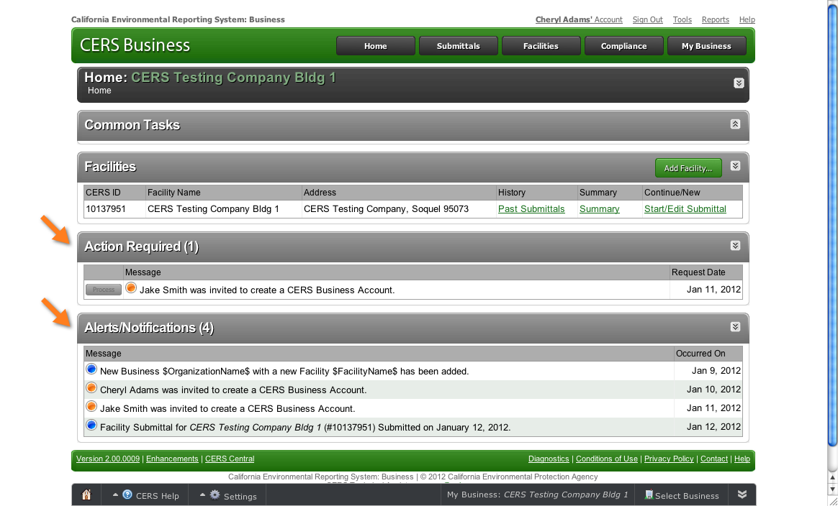
Action Required and Alerts/Notifications
Notes:
Explain
CERS provides prompts on your Home page that tell you when need to take action or when there is an alert or notification.
Point Out
The Common Tasks bar is collapsed which allows you to easily view all the Action Required and Alerts/Notifications information.
Explain
The Action Required areas tells you that Jake Smith, who you added as an Editor, was invited to to create a CERS Business account; he needs to respond to the email in order for the account to be set up.
The Alerts/Notifications section will tell you when the last submittal was made, when the last access request was made, when it was approved or rejected, etc.

Slide 22
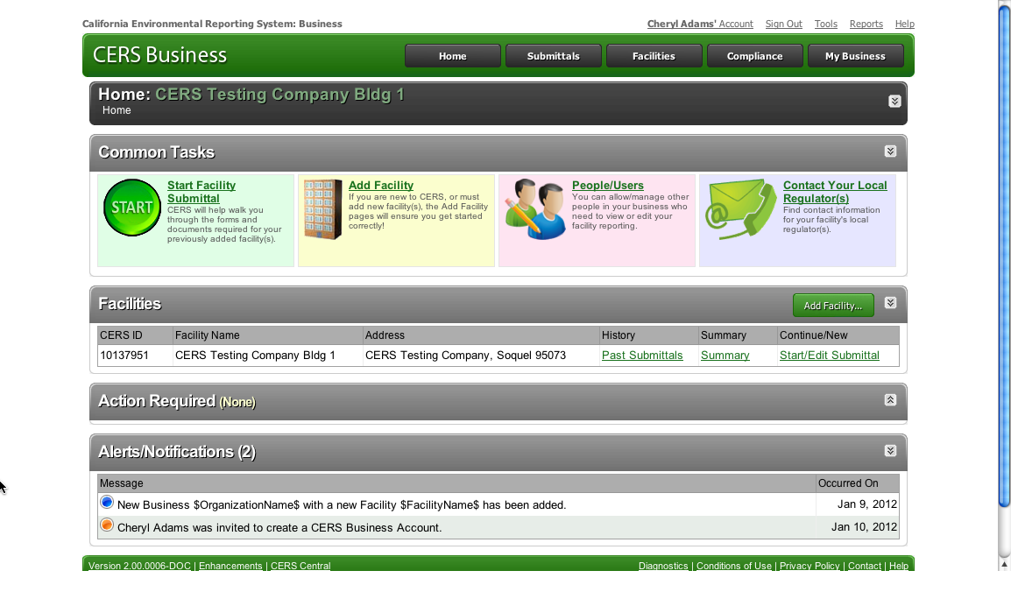
Tools Link
Notes:
Explain
You can access a variety of information and support tools via the Tools link.

Slide 23
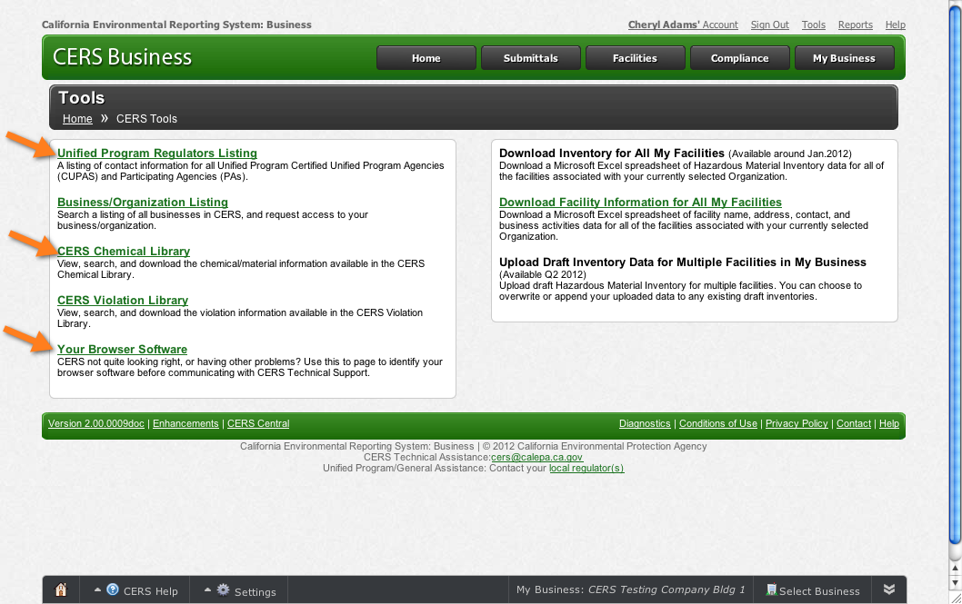
Tools Link
Notes:
Point Out
Two tools you’ve been introduced to can also be accessed through the Tools link—the CERS Chemical Library and the Uniform Program Regulators Listing.
Remember, CERS supports most browsers—except Internet Explorer 7 which is quite old at this time. Internet Explorer versions 8 and 9 have now been released. If CERS is not quite looking right or you’re having other problems, use the Your Browser Software tool to identify your browser software before communicating with CERS Technical Support.
Ask/Point Out
If you needed to contact CERS Technical Support, which link would you use?
For instructions on how to reach CERS Technical Support and other questions, first check with your local CUPA or PA for help. If they cannot help you send an email to the CERS Help Center at CERS@calepa.ca.gov or click on the Help link provided at the top right of the screen.

Slide 24
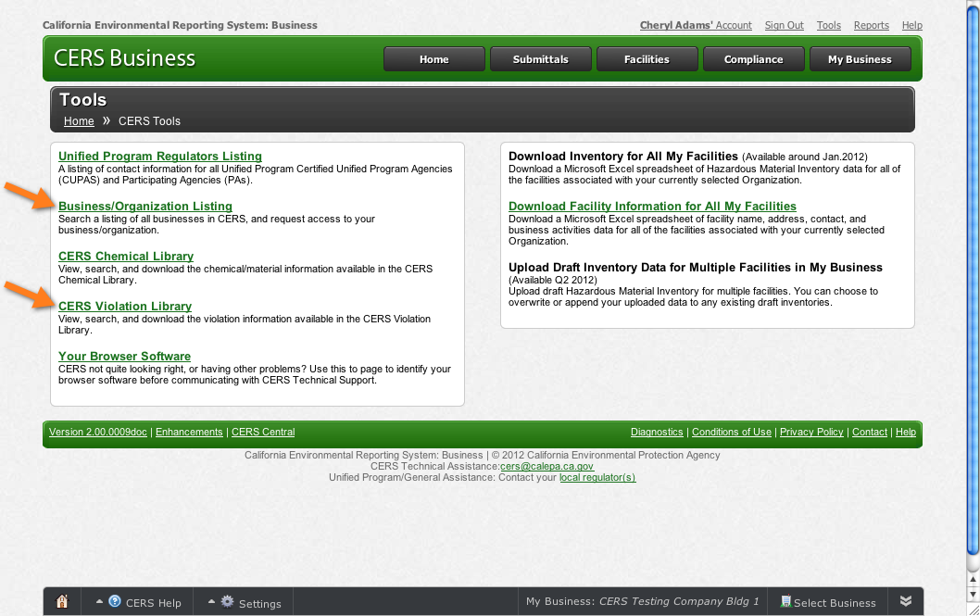
Tools Link
Notes:
Explain
CERS Violation Library - Lets you view, search, and download the violation information available in the CERS Violation Library.
Sample Small Business Template Inventories - Lets you upload draft Hazardous Material Inventory for multiple facilities. You can choose to overwrite or append your uploaded data to any existing draft inventories.
Business/Organization Listing - Lets you search a listing of all businesses in CERS, so you can request access to your business/organization.
Point Out
The Download/Upload section will be developed further in 2012 and 2013 as needs are identified.

Slide 25
Reports Link
Notes:
Point Out
This link is currently under construction; it will list the key reports that can be accessed in the business portal.
Questions?
This is the end of this module. Are there any questions pertaining to this module? Please save your other questions to the end of the presentation.

Slide 26
CERS Business Training
Getting Access/Creating a CERS Account
Module 3

Slide 27
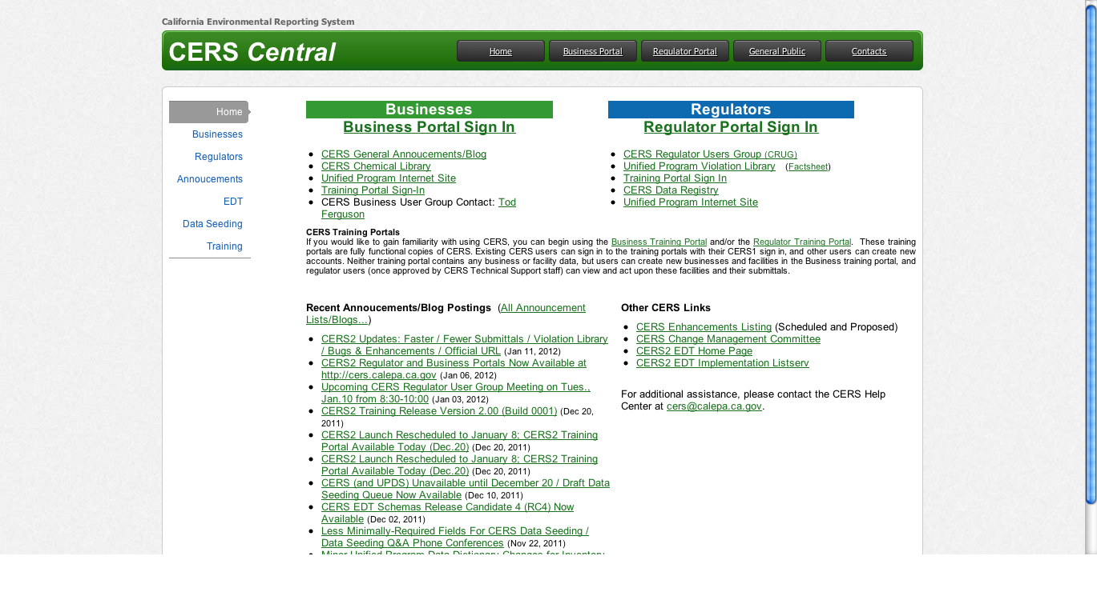
Accessing CERS
CERS Central— http://cers.calepa.ca.gov/
Notes:
Beginning of Module 3: Getting Access/Creating a CERS Account
Explain
Let’s begin with the basics of how to get started with CERS. Everyone that wants to use CERS first needs to create an account, similar to creating an online account to access your banking records. The account has the same security features most modern financial institutions use so you will be prompted to provide several pieces of information.
To get started, go to the CERS Central page and click the Business Portal sign-in link.
Point Out
Direct participants to the CERS Business—Getting Started handout and point out that it contains the URL and the browser information.

Slide 28
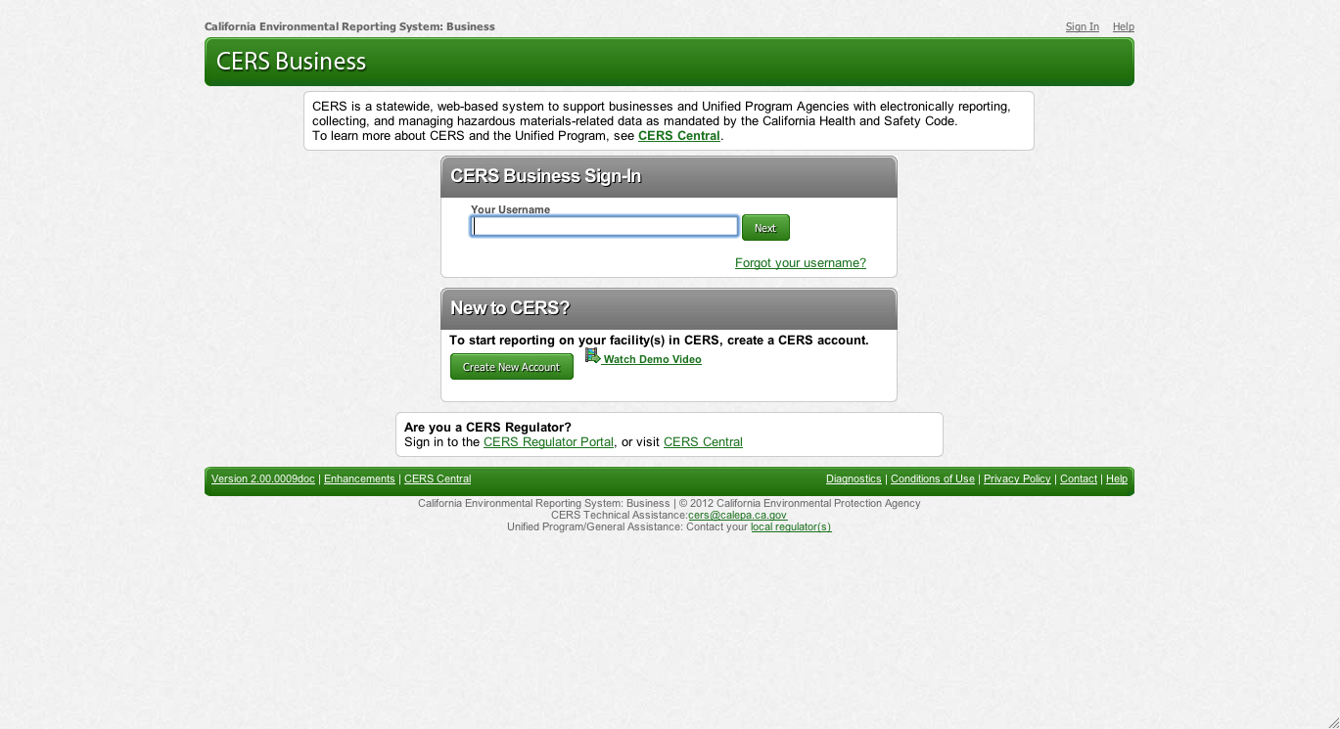
Signing In
Click here to play Sign-In Demo
Notes:
Explain
When you first start in CERS, refer to the ‘New to CERS’ section and select the ‘Create New Account’ button.
After your initial visit to the website you would use the sign in process to login.
Note that the initial set up process includes automated emails that require you to use to activate your account.
If you don’t get an email within a few minutes check your spam or junk folder as the email may be there.
If you do not activate your account within a month of the initial request the process expires and you would need to start over.
Optional-Play Sign-In demo
A video shows how to create a new CERS account. We will view it now and you can always access it on your own.
Click the link to play the Sign-In Demo video.
The demo will play full screen. When the demo ends, you will automatically advance to the next slide.
The demo runs approximately 4 minutes.
If you do not want to play the Sign-In Demo video, simply click forward to the next slide.

Slide 29
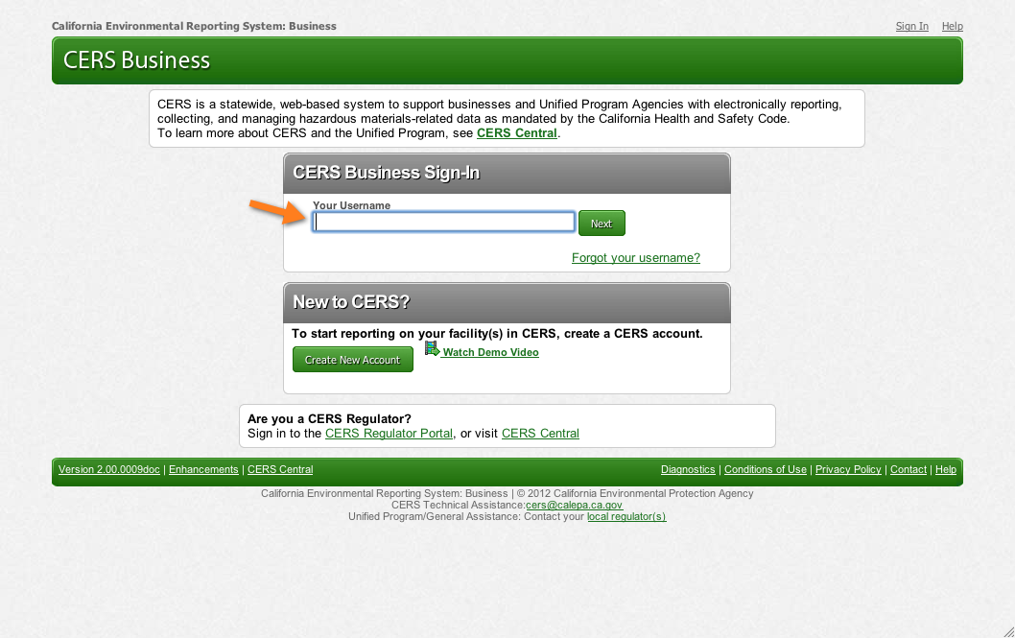
Your CERS User Name
Notes:
Explain
Your CERS username uniquely identifies your account when you sign in to CERS.
CERS 1 users are encouraged to transition to creating a CERS username vs. using their email to access CERS. This is important so you do not lose access to CERS if your email address changes.

Slide 30
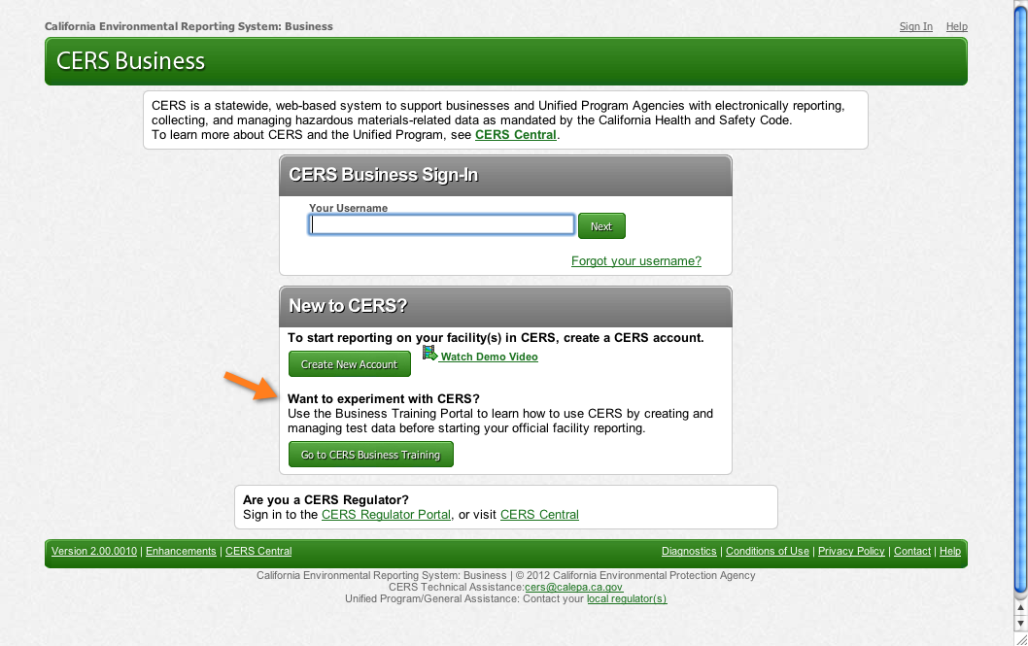
CERS Business Training Site
Notes:
End of Module 3: Getting Access/Creating a CERS Account
Explain
CERS was designed to be easy to use. However, it you want to experiment before starting your official facility reporting CERS has a feature that lets you do that.
Use the Business Training site to learn how to use CERS by creating and managing test data before starting your official facility reporting.
Emphasize
Data entered into the CERS Training site is available for access by anyone and CANNOT be transferred to the CERS production site.
Questions?
This is the end of this module. Are there any questions pertaining to this module? Please save your other questions to the end of the presentation.

Slide 31
CERS Business Training
Finding or Adding a Facility
Module 4

Slide 32
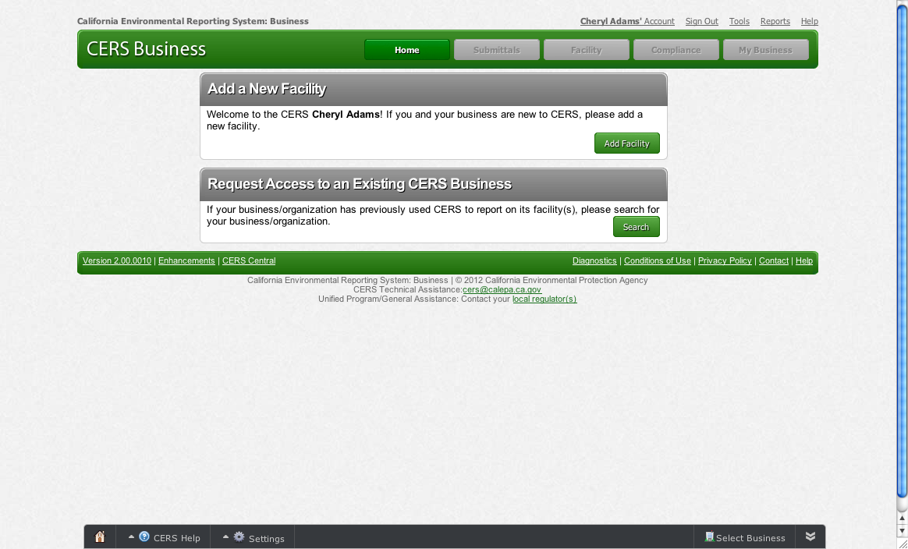
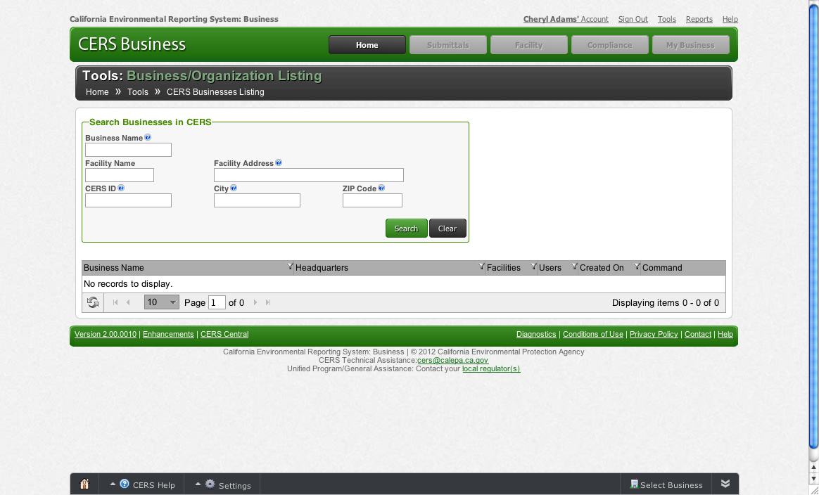
What If Your Business Exists in CERS?
Request Access to an Existing CERS Business
Business/Organization Listing page
Use the Search window to locate your facility or business.
Notes:
Beginning of Module 4: Finding or Adding a Facility
Explain
Most agencies (CUPAs) will pre-populate information, so your facility may already be in CERS.
If your CUPA has pre-populated CERS with your facility information you’ll see the New Facility/Request Access to an Existing CERS Business when you first sign in.
Click Search to bring up the Business/Organization listing, then enter information into one or more of the Search fields and click Search again.

Slide 33
Add a Facility
Steps for adding a new facility
Click the Add Facility button.
Complete address information; click Next.
Complete facility name information; click Add Facility.
Your facility has been added to CERS; click Continue.
Notes:
Point out
When you first sign in to CERS you’ll see this page that allows you to:
Add a new facility, if you and your business are new to CERS
Search for your facility/business/organization if your Business/Organization has previously used CERS
Explain
Since many agencies will pre-populate CERS with your facility information, when you sign in you may get a message saying that the Business/Organization and/or facility already exists. Shortly, we’ll take a look at what to do if that’s your situation.

Slide 34
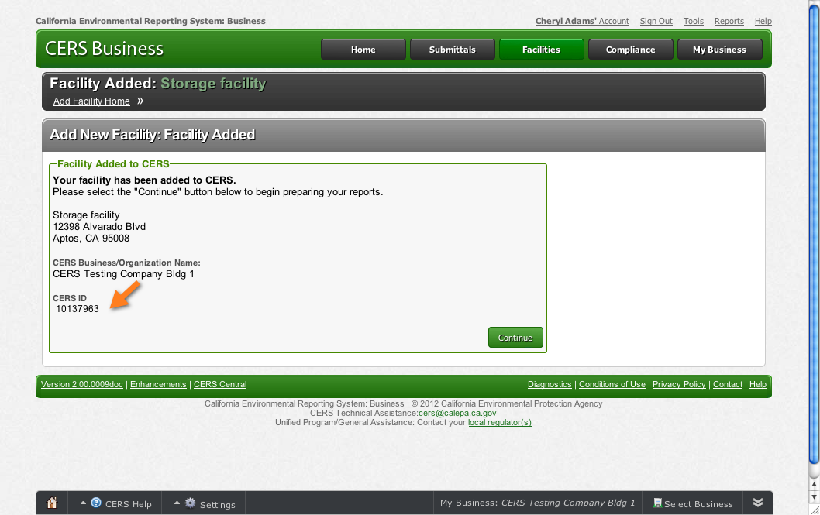
Facility Added
Notes:
Explain
CERS prompts you through adding your facility address and name, and then you’ll see this screen.
Point out
The CERS ID is an important number that can help you find a facility quickly and easily. Similarly, it helps regulators, and ensures that facilities and related records in local systems match facilities and related records in CERS.
Explain
Click Continue to access the Business Activities screen that lets you identify the regulated activities occurring at the facility you added.
Let’s review the information you need to report using CERS.

Slide 35
Your Business Home Page
Notes:
Explain
Once you’ve created a CERS account, when you sign in you’ll be directed
to your Business Home page. As its name implies, the Home page is a
starting point.
From this page, you submit information about your facilities in order to be in compliance.
You can access four Common Tasks from the Home page.
Start Facility Submittal
Add Facility
Manage Users
Contact Your Local Regulator(s)

Slide 36
Summary
Access the CERS Business Portal via CERS Central— http://cers.calepa.ca.gov/
A video shows you how to sign in to CERS
CERS 1 users are encouraged to create a user name
CERS does not support Internet Explorer 7 or earlier versions
Notes:
End of Module 4: Finding or Adding a Facility
Explain
We’ve covered the basics on getting started with CERS.
Direct/Remind
Direct participants to the CERS Business—Getting Started handout and
point out:
Access the Business Portal via CERS Central— http://cers.calepa.ca.gov/
A video shows you how to sign in to CERS
CERS 1 users are encouraged to create a user name
CERS does not support Internet Explorer 7
Questions?
This is the end of this module. Are there any questions pertaining to this module? Please save your other questions to the end of the presentation.

Slide 37
CERS Business Training
Managing Users
Module 5

Slide 38
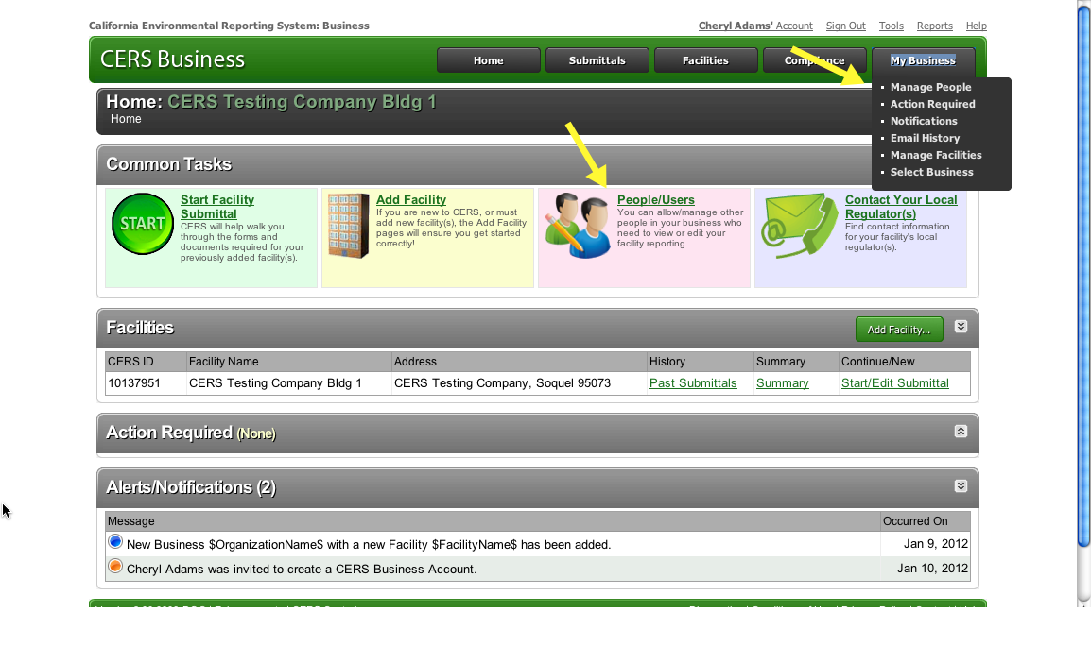
Manage Users
Notes:
Beginning of Module 4: Managing Users
Explain
One important task you should complete quickly is to manage your businesses’ users. These are the other people in your business who need to view or manage data in CERS.
Point out
There are two methods for accessing this task from the Home page. Whichever route you take, you’ll access the page that allows you to assign permissions.

Slide 39
Permission Levels
Lead Users- Can add, remove, and otherwise manage the CERS Business’ users and facilities.
Approvers - May view, edit, and submit facility reports to regulators.
Editors - May add/edit facility reports, but cannot submit reports to regulators.
Viewers- May only view facility reports (read only).
Notes:
Explain
Review the permission levels and recommendations for assigning them:
Lead Users- Can add, remove, and otherwise manage the CERS Business’ users and facilities. Best Practice—assign at least two Leader Users; the business owner and someone else
Viewers- May only view facility reports (read only).
Editors - May add/edit facility reports, but cannot submit reports to regulators. This permission might be given to a consultant.
Approvers - May view, edit, and submit facility reports to regulators. Since this permission level carries legal ramifications, a business owner may want to maintain this permission level.

Slide 40
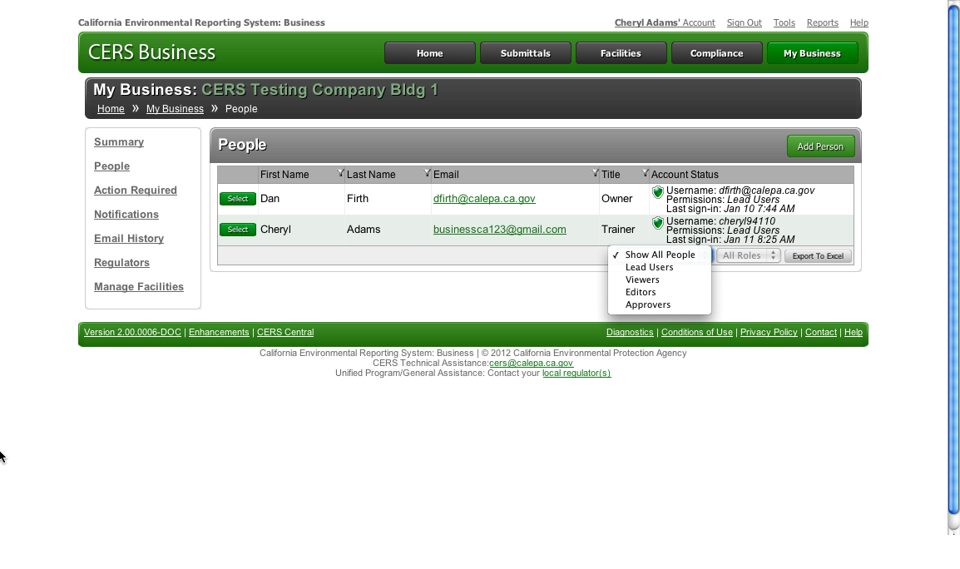
Assigning Permissions
Best Practice Assign at least two Leader Users
Notes:
Point Out
Notice that this business has two Lead User permissions assigned. A suggested Best Practice is to assign at least two Lead Users.
Why? If you limit to one and that person becomes unavailable for any reason the business would need to contact the local CUPA for access permission—if their facility(ies) are within that CUPAs jurisdiction or the business would need to submit a written access request to Cal/EPA if they have facilities in more than one CUPA jurisdiction.
A Lead User can add, remove, and otherwise manage the CERS Organization’s users and facilities.
Explain
Let’s take a look at how to add another Lead User.
Set up an account for the person by clicking the Add User button.

Slide 41
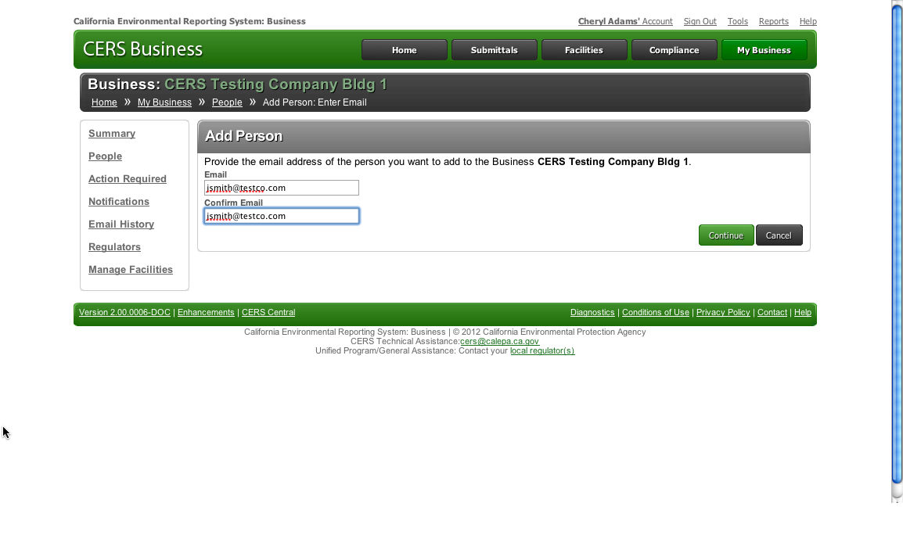
Assigning Permissions
I. Input the person’s email address and click Continue.
2. You’ll be prompted to input the person’s identification information.
3. Input the information and click Continue.
Notes:
Explain
Input the person’s email address and click Continue. You’ll be prompted to input the person’s identification information. Input the information and click Continue.

Slide 42
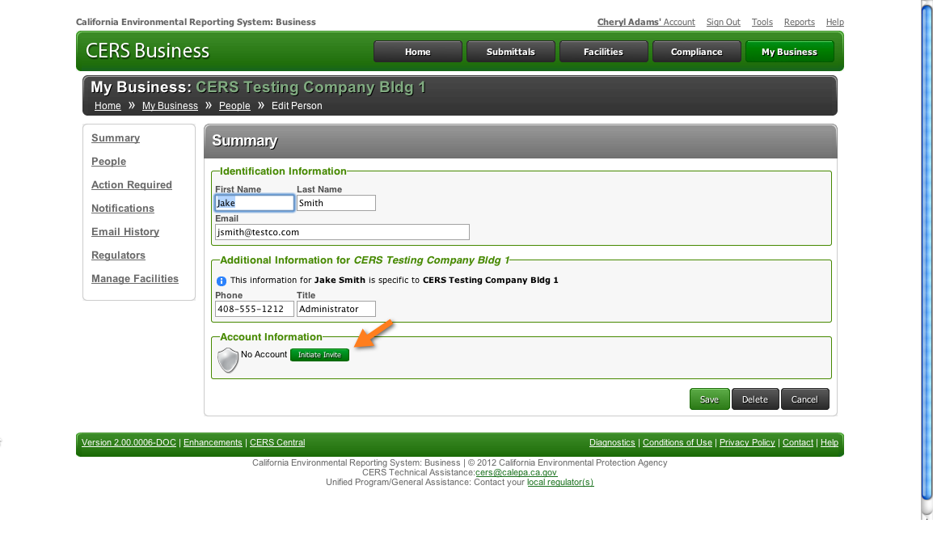
Assigning Permissions
Notes:
Explain
This person does not have an account, so you must initiate an invitation.

Slide 43
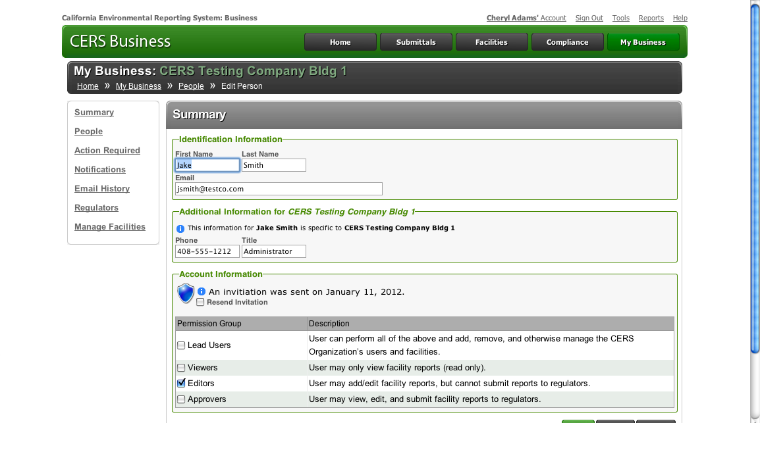
Assigning Permissions
Notes:
Explain
Check the permission(s) you want to assign to this person and click Save & Send Invitation. The person receives an email invitation.

Slide 44
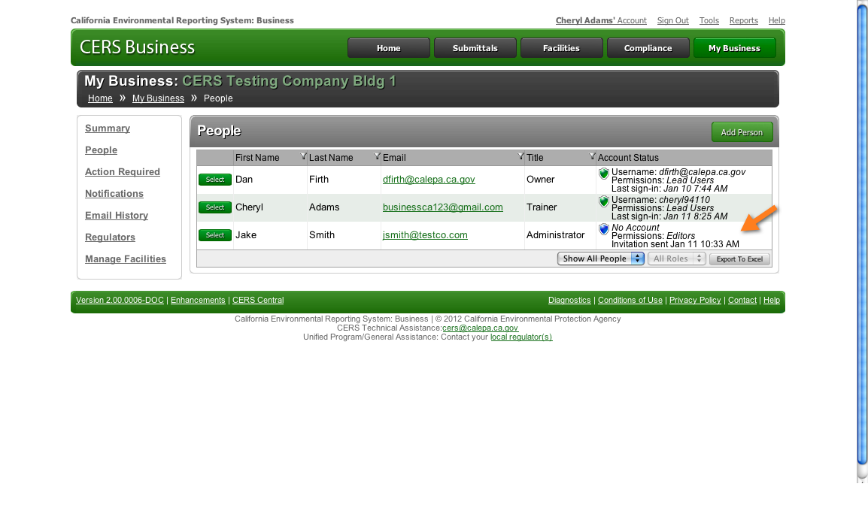
Assigning Permissions
Notes:
Point Out
The Account Status shows that the invitation was sent to Jake Smith to have the permission level of Editor.
Explain
The person must respond to the invitation within 30 days. If they don’t respond, you can resend the invitation.
This business now has the recommended two Lead Users. Let’s review the other permission levels.

Slide 45
Summary
Notes:
For 1-hour presentation: skip this slide.
Explain
You have learned how to complete three of CERS’ common tasks—Add a Facility, Manager Users and Contact Local Regulator(s).
Questions?
This is the end of this module. Are there any questions pertaining to this module? Please save your other questions to the end of the presentation.

Slide 46
CERS Business Training
Making a Submittal
Module 6

Slide 47
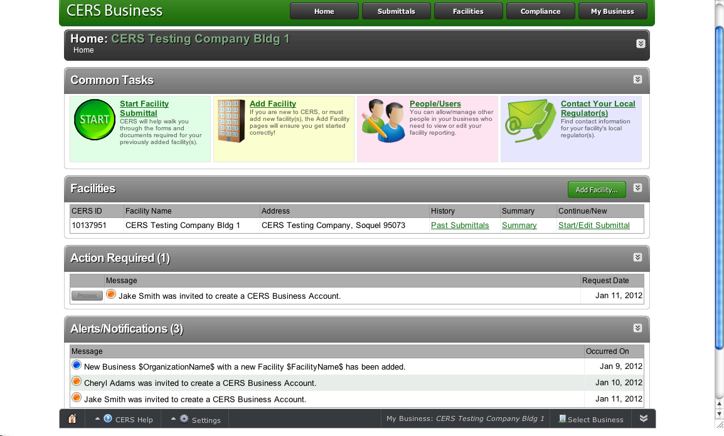
Facility Submittals—Overview
Notes:
Beginning of Module 6: Making a Submittal
Explain
Let’s explore how to complete the fourth common task in CERS—facility submittals.
This is the formal process of reporting and meets legal reporting requirements.

Slide 48
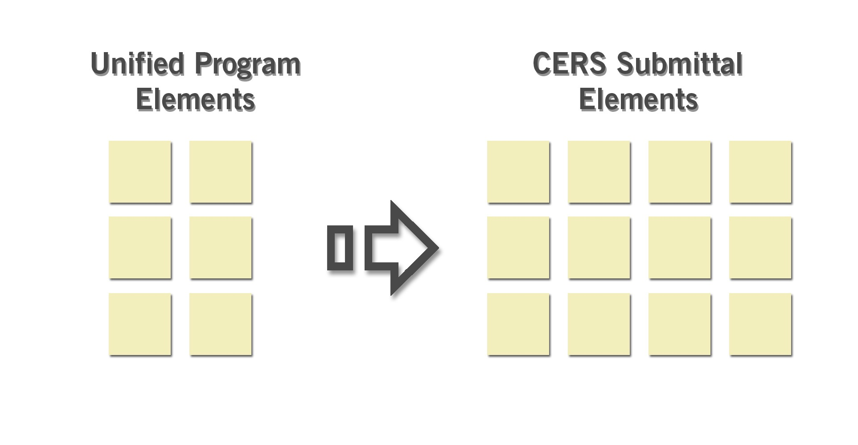
Program Elements
In CERS, the process of reporting information related to the six existing Unified Program elements is broken down into smaller components called submittal elements.
Notes:
Explain
In CERS, the process of reporting information related to the six existing Unified Program elements is broken down into smaller components called submittal elements.

Slide 49
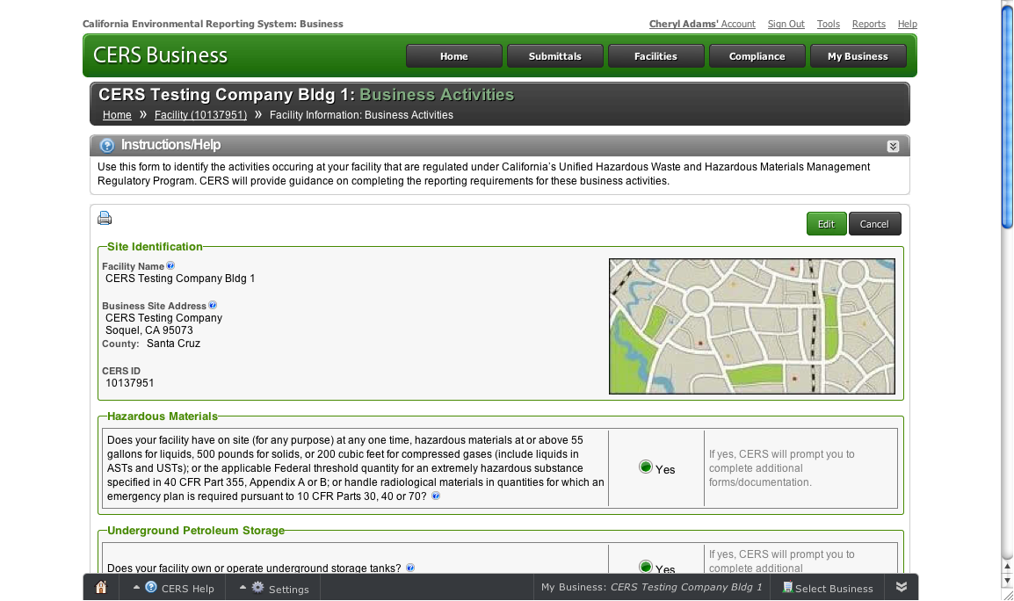
Submittal Elements
Facility Information (Business Activities and Owner/Operator Information
Hazardous Materials Inventory & Map
Emergency Response and Training Plans
Underground Storage Tanks
Onsite Hazardous Waste Treatment Notification
Recyclable Materials Report
Remote Waste Consolidation Annual Notification
Hazardous Waste Tank Closure Certification
Aboveground Petroleum Storage Tanks
California Accidental Release Program
4.3
Notes:
Explain
CERS allows you to submit required information as a complete package or in sections, called Submittal Elements.
The Business Activities/Facility Information submittal element is the first section that every business needs to complete for their facility(ies).
The information you provide via this submittal element determines which other CERS submittal elements are applicable to the facility and what information you need to report. Note that submittal dates vary. Contact your local CUPA or PA if you are unsure of a required submittal date.
Based on your answers, CERS will prompt you to complete one or more of these submittal elements.
Emphasize
The Business Activities/Facility Information submittal is required with ANY other submittal. The Business Activities/Facility Information is normally not submitted by itself, unless you are only updating that element and no other.

Slide 50
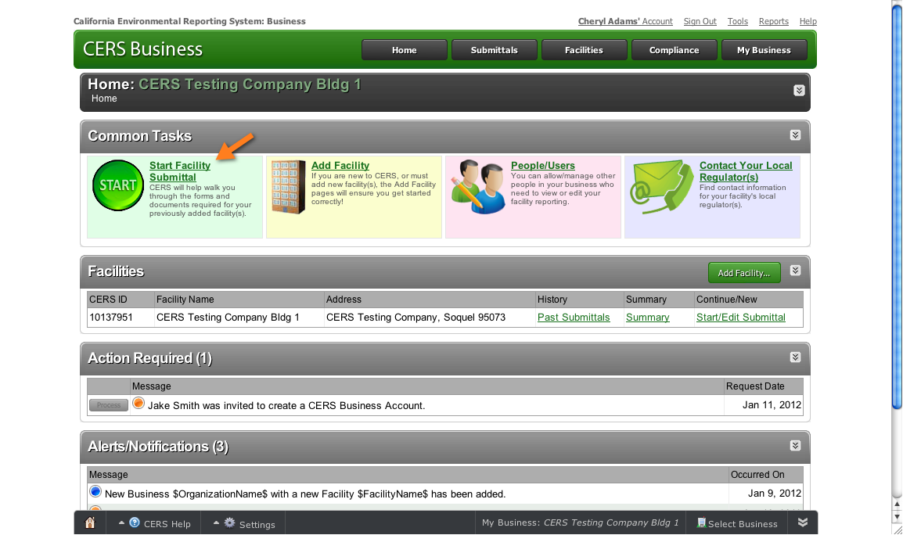
Start Submittal
Notes:
Explain
To begin a facility submittal, click the Start Facility Submittal link on the Common Tasks bar.

Slide 51
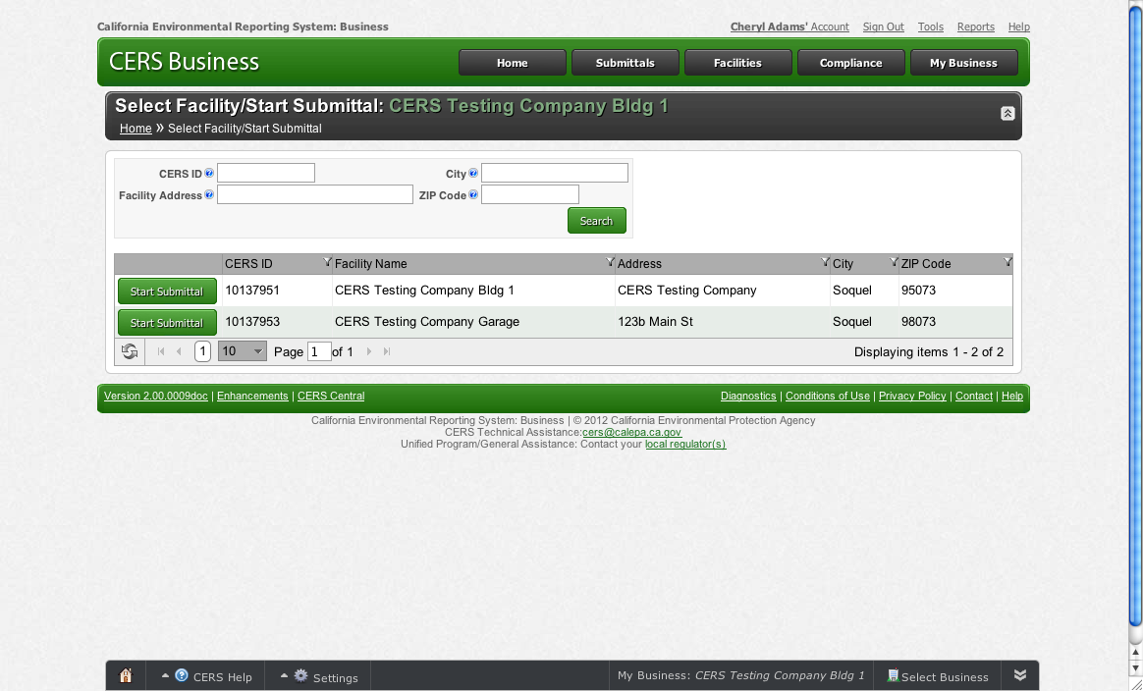
Start Submittal
Notes:
Explain
This page lists the facilities associated with your business—whether it’s 1 or 100+.
If you have multiple facilities you can search for a specific facility.
To begin a facility submittal, click the Start Submittal button.

Slide 52
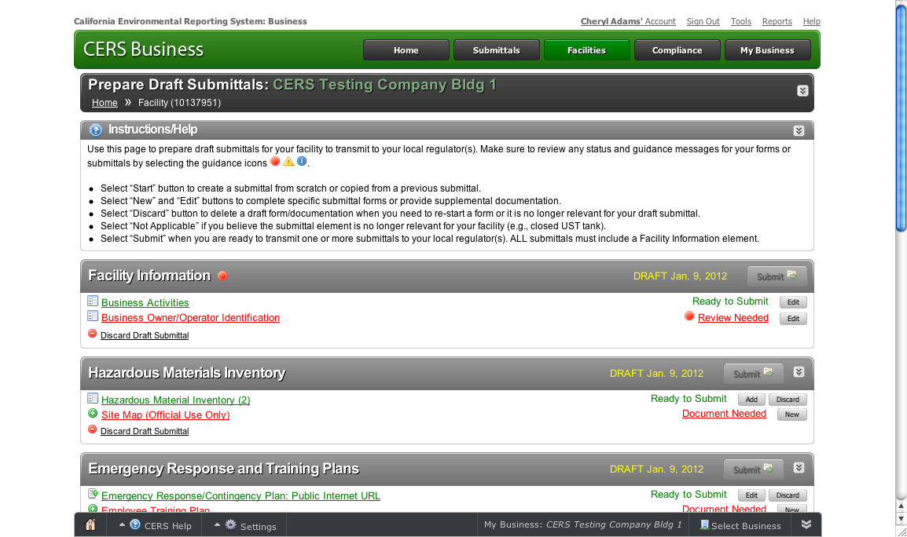
Submittal Status/Guidance
CERS provides information about the status of your submittal(s) and provides guidance messages.
Notes:
Explain
From this page you prepare draft submittals to transmit to your local regulator(s). Make sure to review any status and guidance messages for your submittals by selecting the guidance icons.
Point Out
The Business Activities screen is ready to submit.
The Business Owner/Operator is incomplete. The stop sign shaped red icon alerts you that you need to review the submittal.
Click on the Review Needed link for guidance.

Slide 53
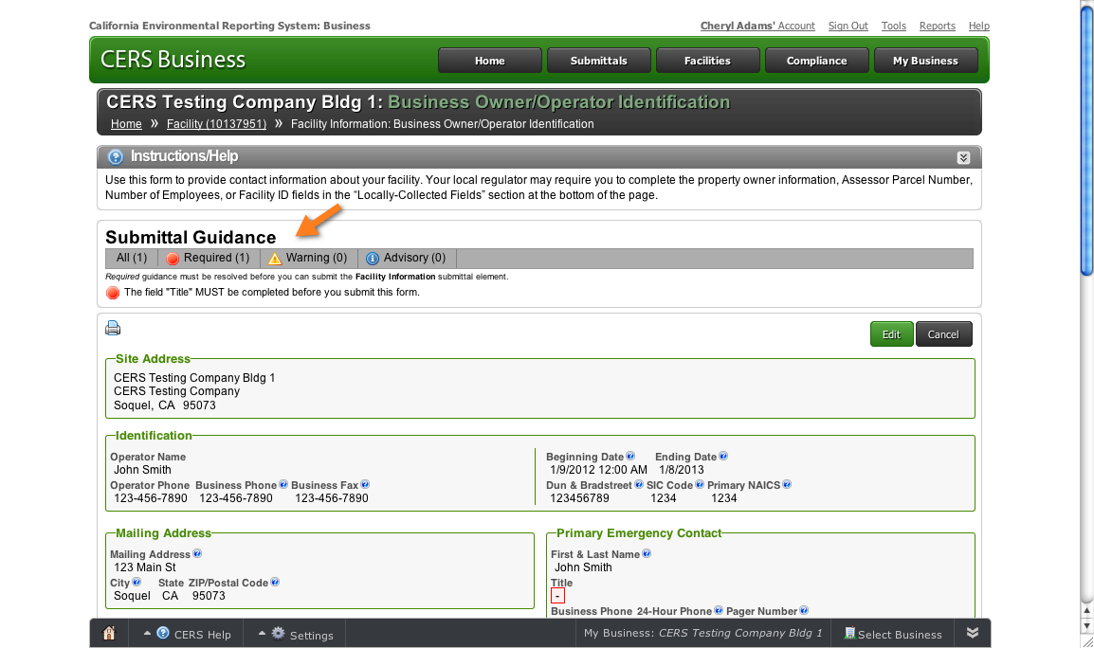
Prepare Draft Submittal
Notes:
Point Out
A field at the top of the page, shows that you are missing required information—the title of the Primary Emergency Contact.
Additionally, that portion of the screen is highlighted in red.
Explain
Provide the necessary information and click Save.

Slide 54
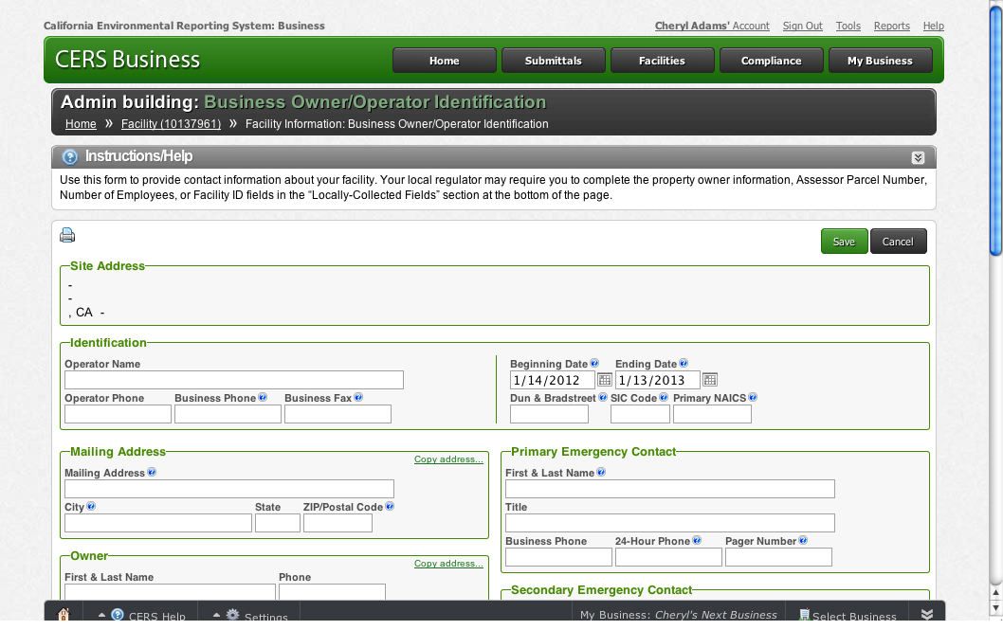
Copy Information
Notes:
Explain
You can select this link to copy name, address and phone numbers to other fields.
For example, if you are the owner, environmental contact and emergency contact, you can copy your information rather than type it in repeatedly.

Slide 55
Submit
Notes:
Point Out
The Business Activities and Business Owner/Operator Identification screens are now ready to submit.
Draft date – Notice the draft date next to the Submittal button; it identifies the last date you worked on the screen.
These screens are complete, however, they need to be submitted.
Click the Submit button when you are ready to transmit the submittals to your local regulator(s).

Slide 56
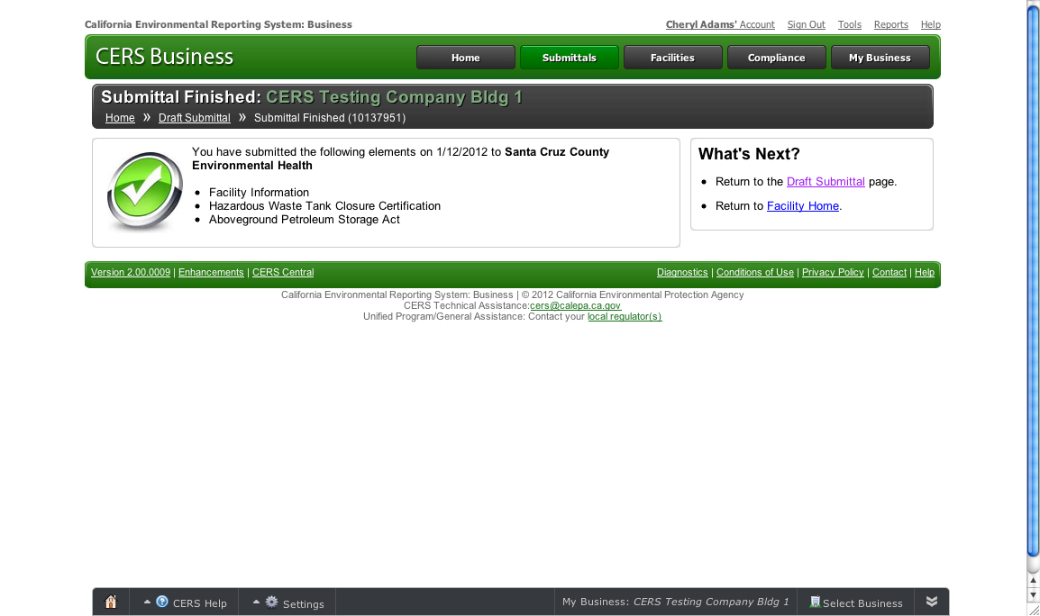
Email Notification
Notes:
Explain
When you submit a screen, both you and the relevant local agency receive an email confirmation.

Slide 57
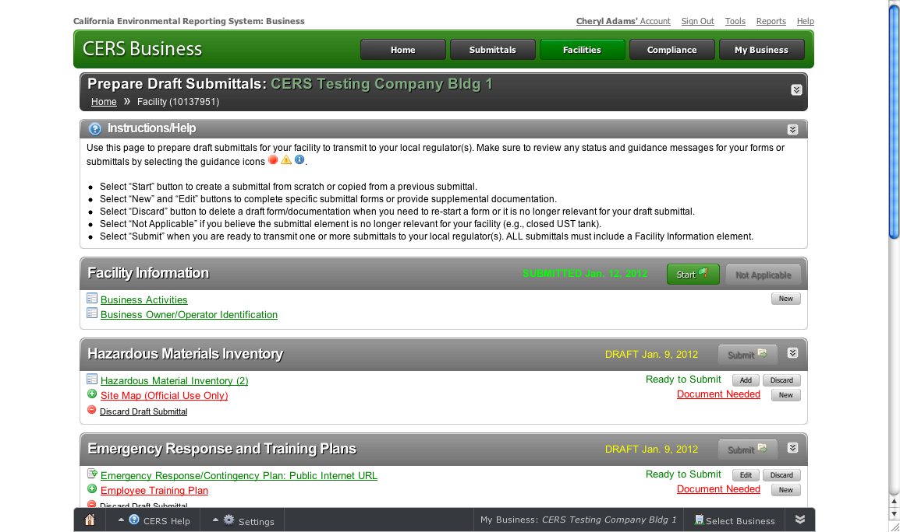
Start/Edit/Review
Notes:
Explain
Let’s briefly review other buttons and options on this page.
Start– Click New to start a new submittal element
To edit an existing submittal screen, click the Edit button. This view shows any deficiencies and offers either a Save or Cancel option.
To review an existing submittal screen, click on the screen name (e.g.: Business Owner/Operator Identification). This view shows any deficiencies and offers either an Edit or Cancel option.

Slide 58
Submittals = Screens + Uploads
Submittal elements may be either a form you fill you or a document you upload.
Submittal elements may be either a screen you fill you or a document you upload.
Notes:
Explain
We’ve reviewed one submittal element—Facility Information which includes both the Business Activities and Business Owner/Operator screens. Note that these are both screens you fill out.
For some of CERS’ submittal elements, such as a Hazardous Materials inventory, you may need to upload a document or other information.

Slide 59
Submittal Elements
Facility Information (Business Activities and Owner/Operator Information
Hazardous Materials Inventory
Emergency Response and Training Plans
Underground Storage Tanks
Onsite Hazardous Waste Treatment Notification
Recyclable Materials Report
Remote Waste Consolidation Annual Notification
Hazardous Waste Tank Closure Certification
Aboveground Petroleum Storage Tanks
California Accidental Release Program
Notes:
Explain
Remember, the information you provide via the Business Activities form determines which CERS submittal elements are applicable and what information you need to report.
Emphasize
Remember that the Business Activities/Facility Information submittal element is required to be submitted with all other submittals.
Poll
Poll the audience to determine how many people have underground storage tanks. Customize the training based on the audience make-up.

Slide 60
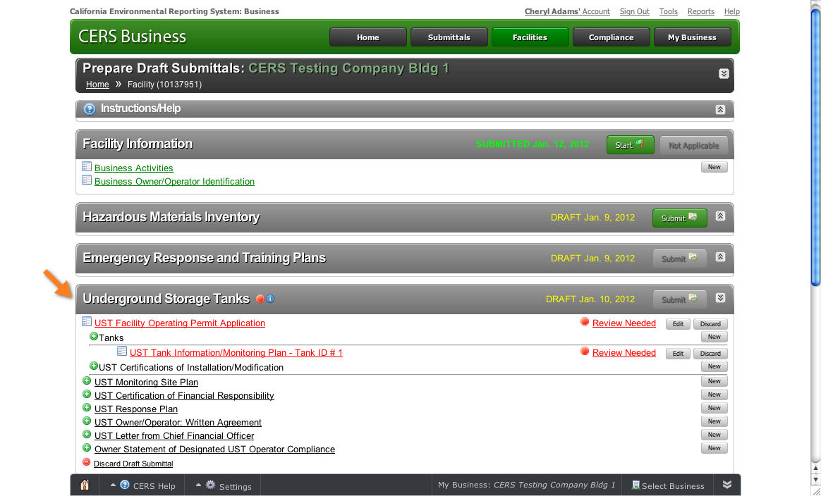
Underground Storage Tanks
Notes:
Ask
What do the messages and icons tell you about these submittal element?
Point Out
There are a number of sections to the Underground Storage Tank (UST) submittal element.
The red message alerts you that you must complete a screen for the UST Facility Operating Permit Application.
The other elements are documents that need to be uploaded.
Explain
You must complete the UST submittal element within 30 days of all new permits, permit changes, or facility information changes. You will also need to update/confirm data relating to your tank, monitoring plan, and upload other pertinent UST-related screens.

Slide 61
Other Submittal Elements
Facility Information (Business Activities and Owner/Operator Information
Hazardous Materials Inventory
Emergency Response and Training Plans
Underground Storage Tanks
Onsite Hazardous Waste Treatment Notification
Recyclable Materials Report
Remote Waste Consolidation Annual Notification
Hazardous Waste Tank Closure Certification
Aboveground Petroleum Storage Tanks
California Accidental Release Program
Notes:
Explain
Each of the other submittal element work in much the same way as the ones we have reviewed so far. You can look over these others at a later time.

Slide 62
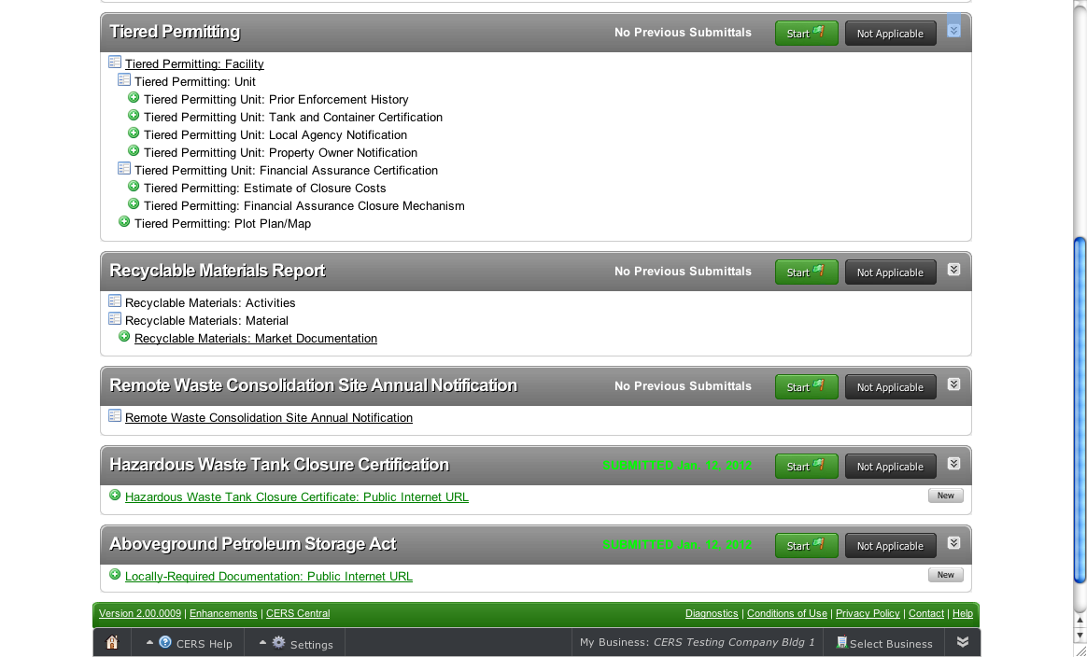
Requirements for Submittal Elements
Notes:
End of Module 6: Making a Submittal
Explain
This screen shows the requirements for the other submittal elements.
Questions?
This is the end of this module. Are there any questions pertaining to this module? Please save your other questions to the end of the presentation.

Slide 63
CERS Business Training
Hazardous Materials Inventory
Module 7

Slide 64
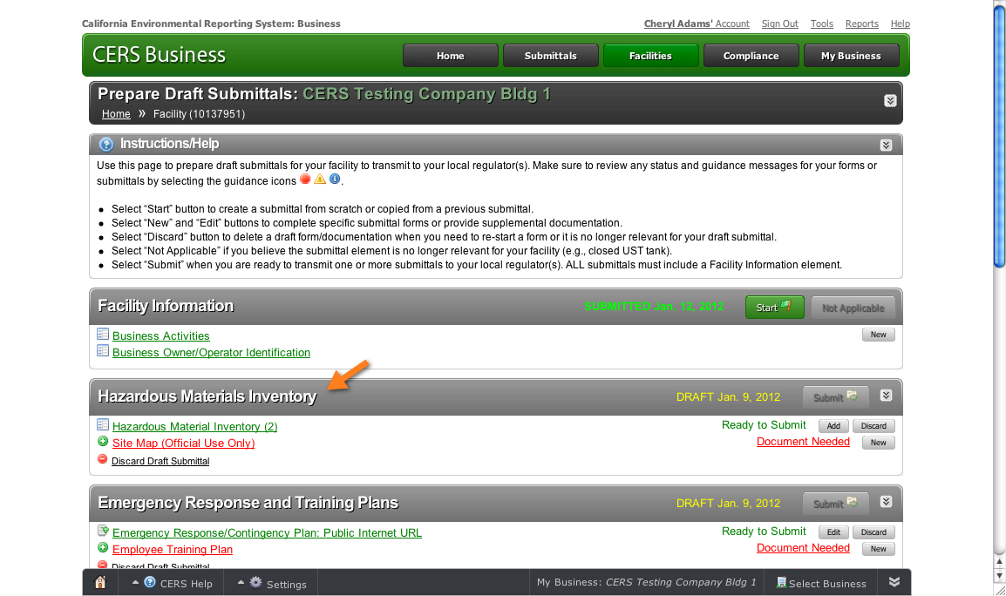
Hazardous Materials Inventory
Notes:
Beginning of Module 7: Hazardous Materials Inventory
Point Out
The Hazardous Materials Inventory must be completed for this facility. CERS shows that this facility’s Hazardous Materials Inventory is ready to submit.
Emphasize
This submittal element is used to annually verify the HMIS

Slide 65
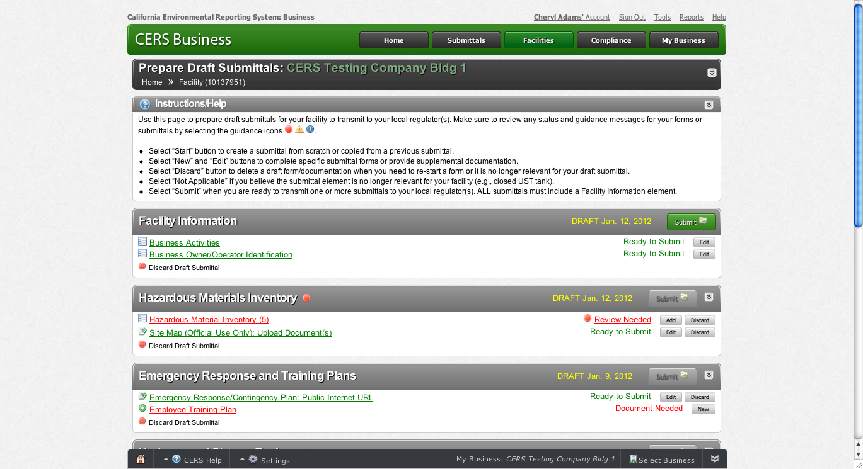
Submittal Elements
Notes:
Point Out
There are two submittal elements needed—the Hazardous Materials Inventory and a Site map.
Notice one is a screen to complete and one is a document to upload. The icons on the left and the text on the right alert you to what is needed.
Also, for the Site Map, the red text alerts you that something needs attention.

Slide 66
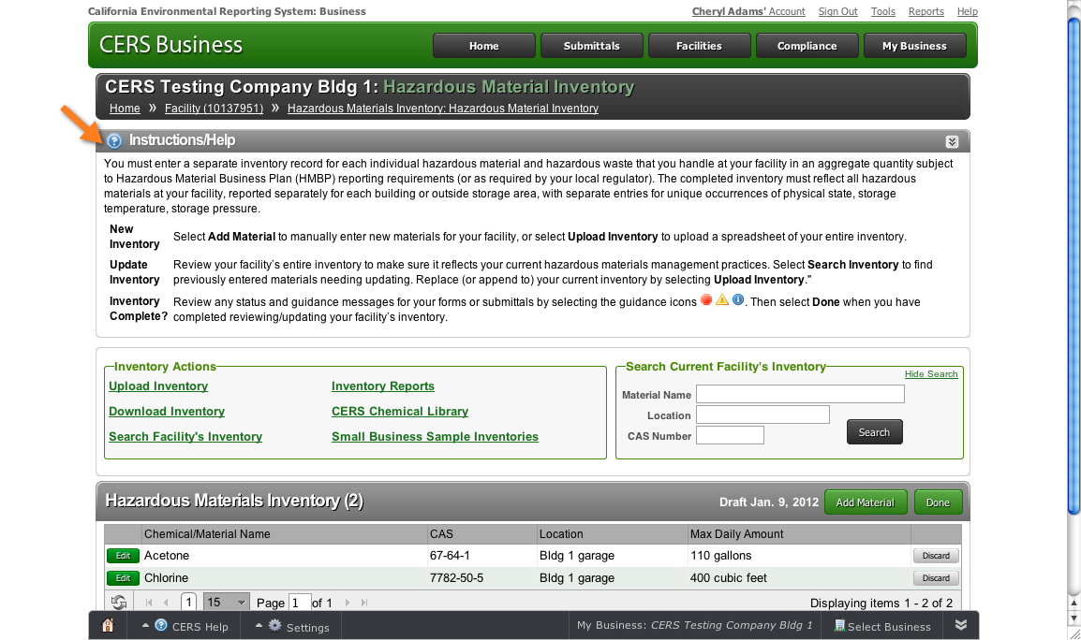
Hazardous Materials Inventory
Notes:
Explain
You must enter a separate inventory record for each hazardous material and hazardous waste that the facility handles in an aggregate quantity subject to Hazardous Material Business Plan (HMBP) reporting requirements (or as required by your local regulator).
The completed inventory must reflect all hazardous materials at your facility, reported separately for each building or outside storage area, with separate entries for unique occurrences of physical state, storage temperature and storage pressure.
Point Out
The Instructions/Help at the top of the page provide directions.
You can create a new inventory or upload an existing inventory.
Some CUPAs and PAs require reporting of any quantity of hazardous materials and/or hazardous waste. You can use this HMIS submittal element to meet that requirement.

Slide 67
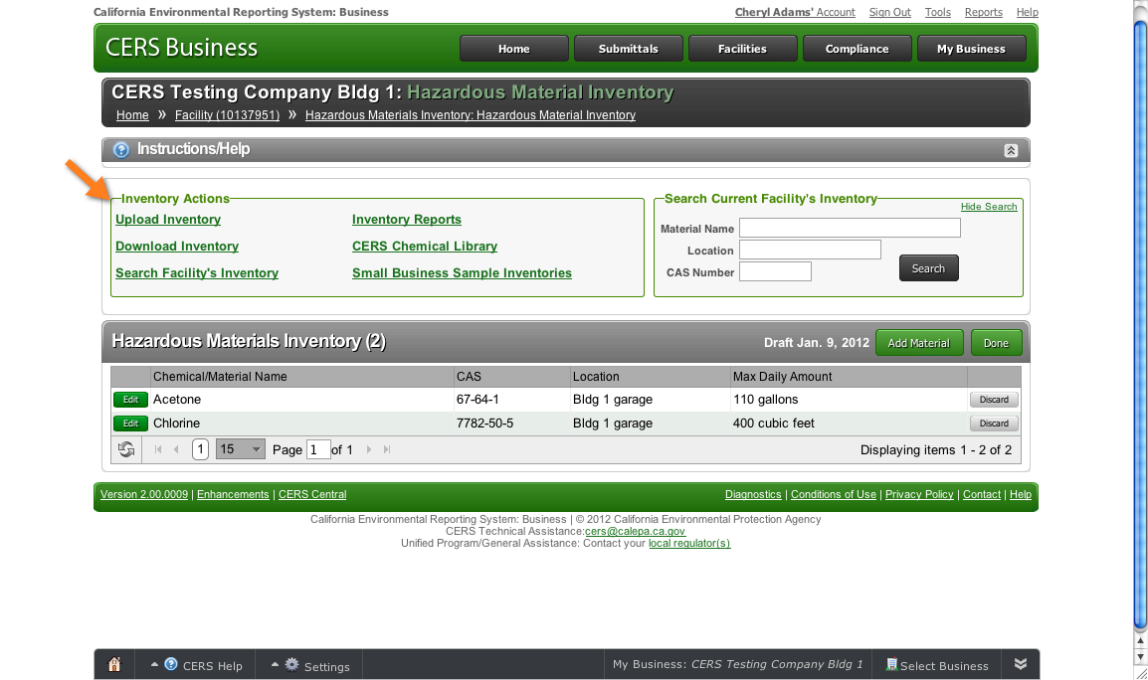
Your Hazardous Materials Inventory
What’s your situation?
Have an inventory but it’s not on CERS
Have an inventory and it is on CERS
Do not currently have an inventory
Notes:
Poll
Poll participants to determine the current status of their inventory(s).
Customize the training accordingly.

Slide 68
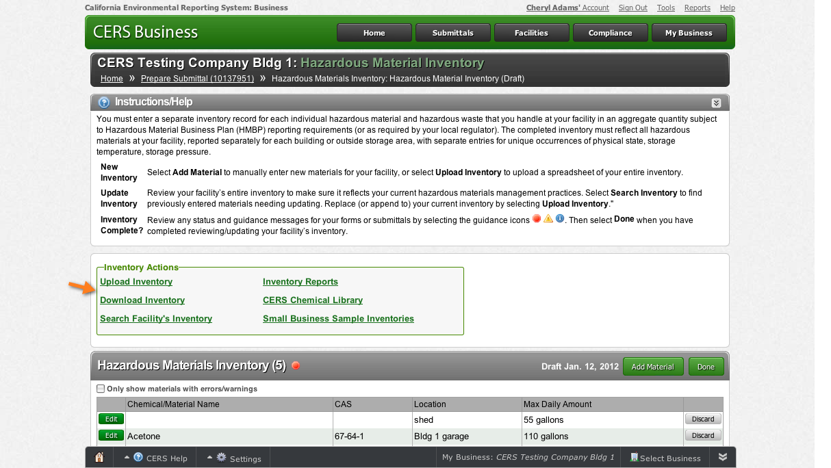
Upload/Download an Existing Inventory
Notes:
Explain
Review steps for uploading or downloading an existing inventory.
If you upload a facility's inventory, the process is similar to uploading any other document to CERS.
Keep in mind that the inventory spreadsheets you upload must match the columns and format as shown in the CERS Hazardous Material Inventory Upload Template.
You can download your inventory in an Excel format for printing, uploading to another facility (If you have more than one), or for other needs you may have.

Slide 69
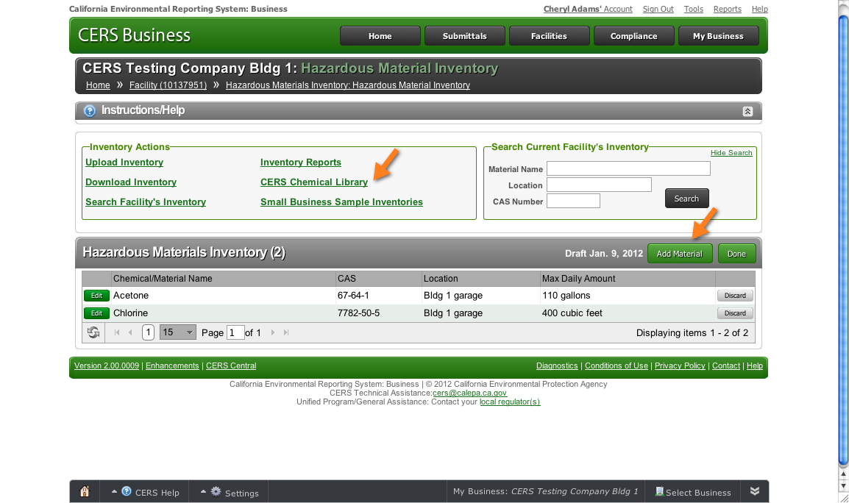
New Hazardous Materials Inventory
Notes:
Explain
Use the CERS Chemical Library if you don’t have a Hazardous Materials Inventory created or you need to add a new material to your inventory.
Point Out
To begin creating an inventory, click Add Materials.
Clicking the CERS Chemical Library link opens a new window and takes you outside your CERS account. You can build your inventory and then export it into CERS.
For 1-hour presentation: skip this explanation.
Explain
We will use the Add Materials button to begin building an inventory. But first lets briefly review the other Inventory Actions— Search Facility’s Inventory, Inventory Reports and Small Business Samples.

Slide 70
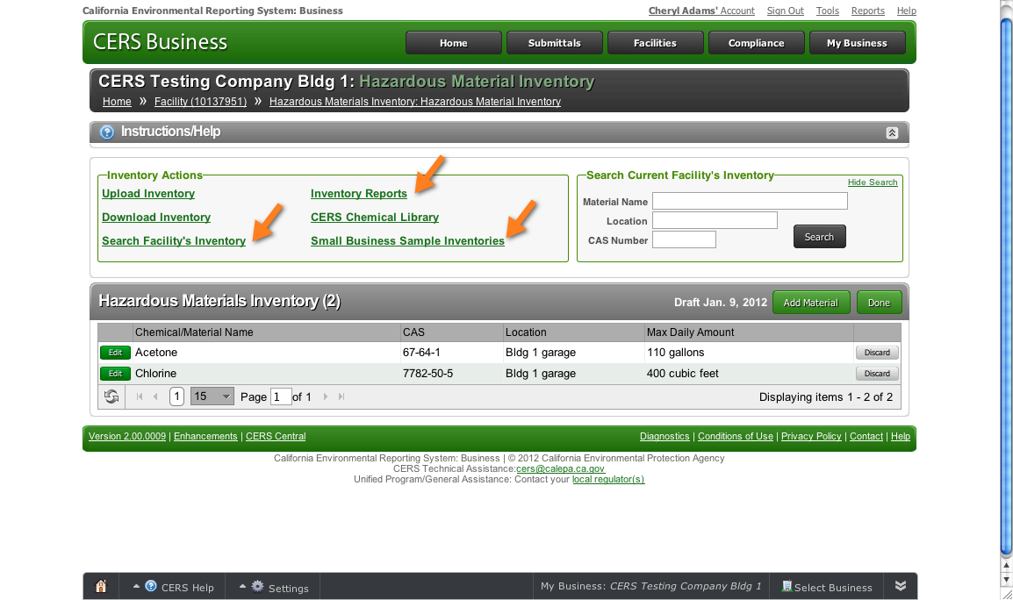
New Hazardous Materials Inventory
Notes:
For 1-hour presentation: skip this slide
Explain
Search Facility’s Inventory link: Use this to search a large inventory for a specific material.
Inventory Reports link: Use this to generate a printable one page per chemical or matrix-formatted inventory report.
Small Business Samples link: This feature is under enhancement to display sample inventories for a variety of business types such as Auto Body Shop, Photo Developing, Dry Cleaner, Gas Station, etc. These templates can be easily customized for submittal by a business for their facility(ies).

Slide 71
CERS Chemical Library—Its Benefits
You can use the CERS Chemical Library or your own resources to complete the Hazardous Materials Inventory. .
Notes:
For 1-hour presentation: skip this slide
Explain
To complete the inventory, you can use the CERS Chemical Library or your own resources. The CERS Chemical Library contains ~75,000 chemical names and CAS numbers from the US EPA Federal Substance Registry.
Emphasize
Using the CERS Chemical Library has these benefits for you, regulators and first responders:
Saves you time
Ensures consistency of chemical names and CAS numbers for all users
Your inventory is automatically populated with hazard property information for many chemicals in the Library.
Provides first responders with confidence in the data reported
You can use your own resources to build the inventory. This is necessary for any material not listed in the CERS Chemical Library.
If you choose to use your own resources for a material that is fully categorized in the CERS Chemical Library you may be tasked with justifying discrepancies to the local CUPA or PA.
Let’s review how to use the CERS Chemical Library to build your inventory. Begin by clicking Add Material.

Slide 72
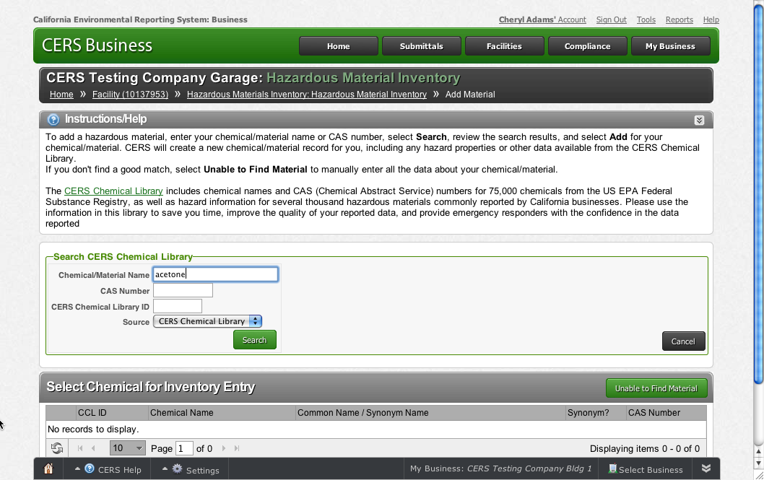
CERS Chemical Library—How To
Enter chemical/material name or CAS number
Select Search
Notes:
Explain
Let’s say that you want to add acetone to your inventory.
Enter the chemical/material name or the CAS number
Select Search

Slide 73
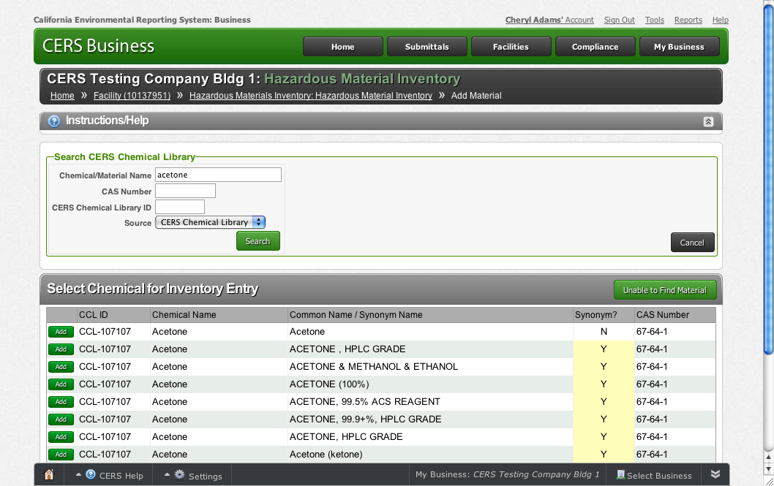
CERS Chemical Library—How To
Notes:
Explain
Review the results, find the correct chemical/material and click Add.
Point Out
If you don't find a good match, select Unable to Find Material in order to manually enter the data about the chemical/material.

Slide 74
CERS Chemical Library—How To
Notes:
Point out
CERS creates a new chemical/material record, including any hazard properties or other data available from the CERS Chemical Library.
Some sections are automatically filled in— Chemical Identification and Physical Properties, and Chemical Hazard Classification.
You need to complete the remaining sections—Inventory Location and Quantity, Inventory Storage Information, and Mixture Components.

Slide 75
CERS Chemical Library—How To
Notes:
Point out
You need to complete the remaining sections—Inventory Location and Quantity, Inventory Storage Information, and Mixture Components.
Once you complete that information, click Save.

Slide 76
CERS Chemical Library—How To
Notes:
End of Module 7: Hazardous Materials Inventory
Point Out
The Hazardous Materials Inventory is ready to submit.
Explain
One other submittal element is needed—a Site Map. Site Maps, also called Facility Maps or Site Plans, are typically required by regulators for emergency response purposes.
Click New to begin.
Questions?
This is the end of this module. Are there any questions pertaining to this module? Please save your other questions to the end of the presentation.

Slide 77
CERS Business Training
Uploading Maps & Documents
Module 8

Slide 78
Site Map
Notes:
Beginning of Module 8: Uploading Maps & Documents
Point Out
Your local regulator may require submission of one or two site maps.
Contact your regulator with questions about these requirements.
Note: Two typical types of site maps are:
A general site plan that can include, but not be limited to, the location of buildings, exterior storage facilities, permanent access ways, evacuation routes, parking lots, internal roads, chemical loading areas, equipment cleaning areas, storm and sanitary sewer accesses, emergency equipment and adjacent property uses.
A building floor plan that includes hazardous materials storage areas within the building, rooms, doorways, corridors, means of egress and evacuation routes.
Your local CUPA or PA may suggest or prefer that these maps be consolidated into one or changed in other ways to benefit emergency response personnel.
Explain
Upload the document, as you would any other type of upload: Click the Browse button; Locate the file on your computer; Select Save & Finish to complete the upload.
Point Out
Notice that the Upload Document(s) button is selected in the Document Options field. That’s because your local regulator must approve other document options.

Slide 79
Emergency Response and Training Plans
Notes:
Point Out
Another document upload is the Emergency Response Emergency Response/Contingency Plan and Employee Training Plan. This submittal is required every three years.
The red Document Needed messages alert you that these elements have not been submitted.
Let’s see what’s needed for the Emergency Response/Contingency Plan.

Slide 80
Emergency Response and Training Plans
Notes:
Explain
You must submit an emergency response/contingency plan for your facility. Contact your local regulator for more information about providing a suitable plan.
Ask/Explain
How many people have an existing emergency response/contingency plan?
If you don’t have a plan, you can use the template provided in CERS or contact your local regulator about providing a suitable plan.
Questions?
This is the end of this module. Are there any questions pertaining to this module? Please save your other questions to the end of the presentation.

Slide 81
CERS Business Training
Businesses/Organizations
Module 9

Slide 82
Facility and Business
Facility
A building or buildings, structure or structures at a fixed location.
Could be a single underground storage tank (UST), a single building or a campus depending on the local agency definition.
Business
An employer, self-employed individual, trust, firm, joint stock company, corporation, partnership, or association.
Includes for profit and nonprofit businesses. A city or a county would also be a business.
Notes:
Beginning of Module 9: Businesses/Organizations
Explain
Let’s begin by defining some CERS’ terms.
Facility: A facility is a building or buildings, structure or structures at a fixed location where hazardous materials/wastes subject to regulation under the Unified Program are used, handled or stored. It could be a single underground storage tank (UST), a single building or a campus depending on the local agency practice.
Business: Business is defined in Health and Safety Code Section 25501(e): An employer, self-employed individual, trust, firm, joint stock company, corporation, partnership, or association. It includes a business organized for profit and a nonprofit business. A city or a county would be included in this definition of a business.

Slide 83
Organization
For a multi-facility business, the organization may be an abbreviated business name or other name as determined by the business.
In CERS, Business refers to the Business/Organization name and not the facility name.
Notes:
Explain
Organization is a non-legal term coined specifically for CERS. It allows a business to manage a group of facilities that are associated with that business and to manage users who are authorized to access or report information for those facilities.
For a business with only one facility, the Business/Organization name and facility name would be the same.
For a business that has more than one facility, this term may be an abbreviated business name or other name as determined by the business. In CERS, Business refers to the Business/Organization name and not the facility name.

Slide 84
Benefits of an Organization
Notes:
Explain
If a business doesn’t already have access to their facilities in CERS, they would have to request access to each site from the local CUPA. If they have facilities in 20 CUPAs, the result is more work for the business and the CUPAs, too.
However, If a business is set up as an organization, the business can ask Cal/EPA to approve access to all of their facilities at one time.
The business can also directly manage the users that have access to these facilities.

Slide 85
Summary—Assigning Permissions
Benefits of a Business/Organization
Assign user access permission to users for all facilities at one time
Assign, change or remove access permission for one person for all facilities in the organization
Notes:
For 1-hour presentation: skip this slide.
Remind/Ask
Briefly review the definition of a Business/Organization; or ask a participant to define it.
Explain
When assigning permissions, there are these benefits to setting up a multi-facility business as an organization:
If a business has more than one facility, the business can identify all of their facilities within the organization and they can assign user access permission to their users for all the facilities at one time. If they don't have an organization, the business would have to assign access for each facility individually and each user separately.
Under an organization, a business can assign, change or remove access permissions for one person for all facilities in the organization. In a non-organization, the user permissions are set and changed per facility.

Slide 86
Navigation Tip
Notes:
Point out
If you are a consultant and represent more than one Business/Organization, you can easily navigate from one Business/Organization to another Business/Organization.
Explain
Click the Account link to see a list of all businesses (not facilities) associated with your CERS Account.
Select one of the businesses to view its facilities.

Slide 87
Submittal History
Notes:
For 1-hour presentation: skip this slide.
Explain
The Submittal History page lists all submittals for ALL facilities currently associated with your business.
Data entered into CERS but not submitted is stored in CERS as a draft submittal but not displayed in the list of submittals (because it hasn’t been submitted).
To view past submittals for facilities no longer associated with your business, view the Archive.

Slide 88
Submittal Information
Notes:
For 1-hour presentation: skip this slide.
Explain
If you have more than one facility, it’s easy to access submittal information for a specific facility— begin by clicking the Submittal button on the Task Bar.

Slide 89
Navigation Tip—Use the Tray
Notes:
For 1-hour presentation: skip this slide.
Explain
The My Business button in the Tray takes you to a Business Summary page.

Slide 90
Business Summary Page
Notes:
End of Module 9: Businesses/Organizations
For 1-hour presentation: skip this slide
Explain
On the Business Summary page you see general information associated with the business and a list of people and their Account Status.
Questions?
This is the end of this module. Are there any questions pertaining to this module? Please save your other questions to the end of the presentation.

Slide 91
CERS Business Training
Wrap Up
Module 10

Slide 92
CERS Online Reporting—Resources
Notes:
Explain
If you have questions about using CERS for online reporting, refer to your CUPA or PA. You can also request help from the CERS Help Center via the link on your Home page.
Point Out
Remind participants they also have the CERS Business—Getting Started handout that provides information to help them get started using CERS.
Thank you for joining is

Slide 93
CERS Business Training
Questions?
Notes:
Questions Are there any further questions on the modules we presented today? Are there any other CERS related questions?

